Slide 1
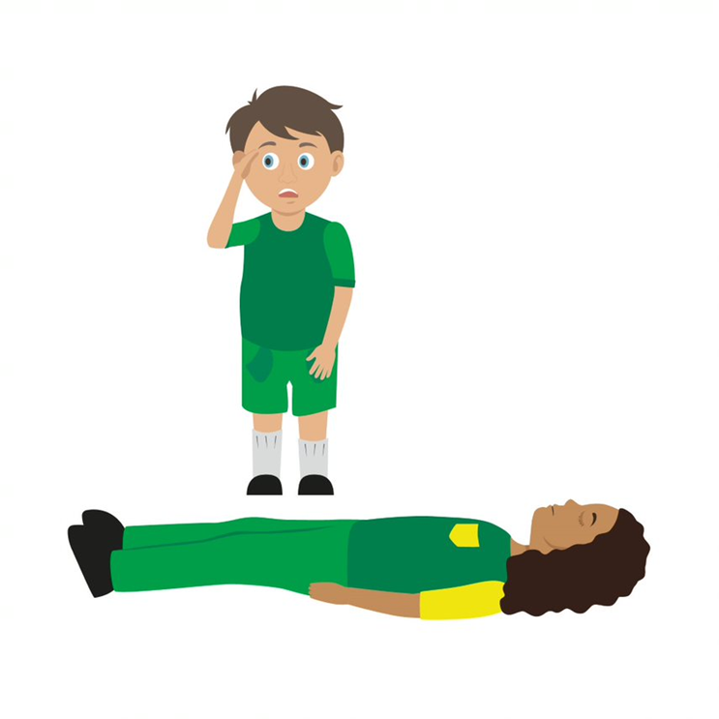

Your turn: Primary survey
1. Check for danger
Always make sure the area is safe
2. Response
Check the casualty’s response. Ask questions and gently tap shoulders. Say “open your eyes!”
3. Shout for help
Anyone nearby can assist you
4. Airway
If not clear, then open by tilting the head back, use one hand on forehead and two fingers under the chin
5. Breathing
Check for normal breathing. Do not put your face next to theirs, instead look at chest rising and falling only. (Remember 10 seconds!)
6. Circulation (only if breathing normally)
Check the casualty for bleeding
NB
At this time do not put your face near to theirs to check for breathing, instead look at chest rising and falling only
If the casualty is not breathing normally call 999/112 then start CPR
If the casualty is breathing normally place them in the recovery position then call 999/112
KS4 – Basic Life Support
Notes:
Scenario cards are available which the teacher can use to make the practical activity relevant in a certain context for students.
Trainer demonstrates then gets the students to practice using either the PP slide as a prompt or the sheet in the workbook. Trainer circulate and correct as necessary

Slide 2
Your turn: Recovery position
1. Kneel
By the side of your casualty
2. Angle arm
Put the arm nearest to you to make a right angle. Palm facing upwards
3. Hand to cheek
Bring the arm furthest away across the chest and place the back of their hand against the cheek nearest to you
Hold it there
4. Knee bend
With other hand, bend their far knee up so that the foot is flat on the floor
5. Knee pull
Pull on the knee to roll the casualty towards you onto their side
Adjust them as necessary
6. Ensure airway is open
Recheck breathing
Call 999/112
Stay and monitor casualty until help arrives
KS4 – Basic Life Support
Notes:
Scenario cards are available which the teacher can use to make the practical activity relevant in a certain context for students.
Trainer demonstrates then gets the students to practice using either the PP slide as a prompt or the sheet in the workbook. Trainer circulate and correct as necessary

Slide 3
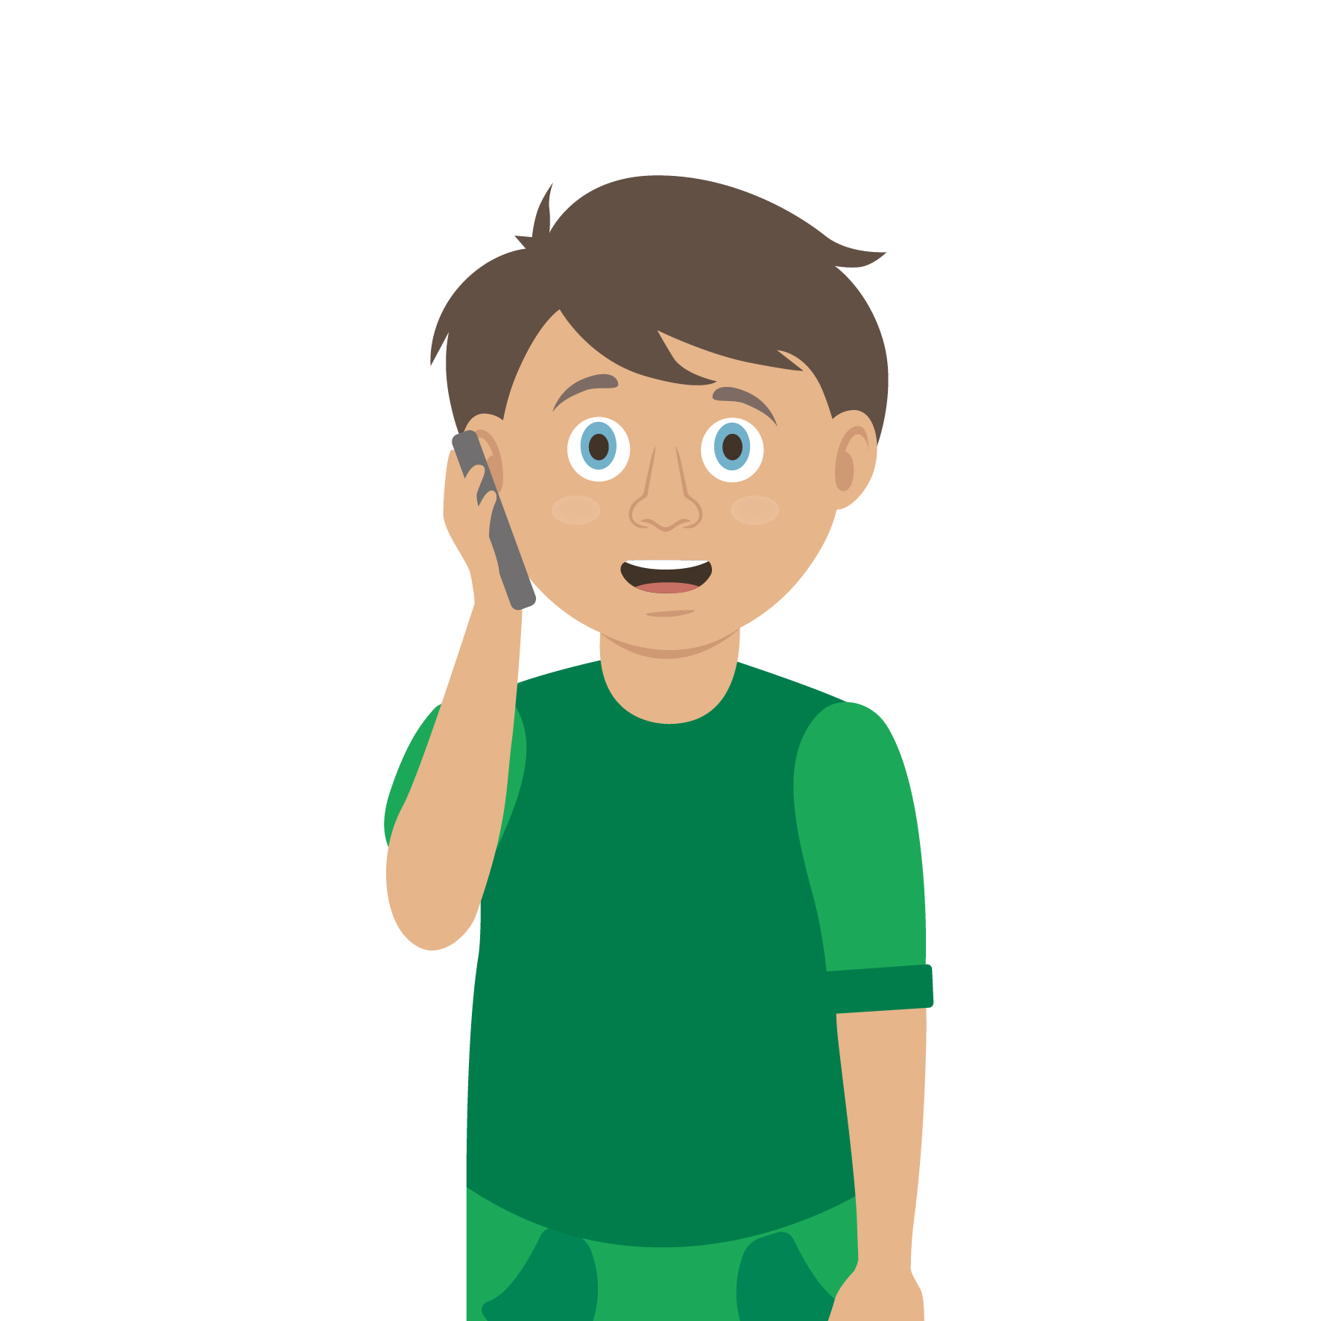
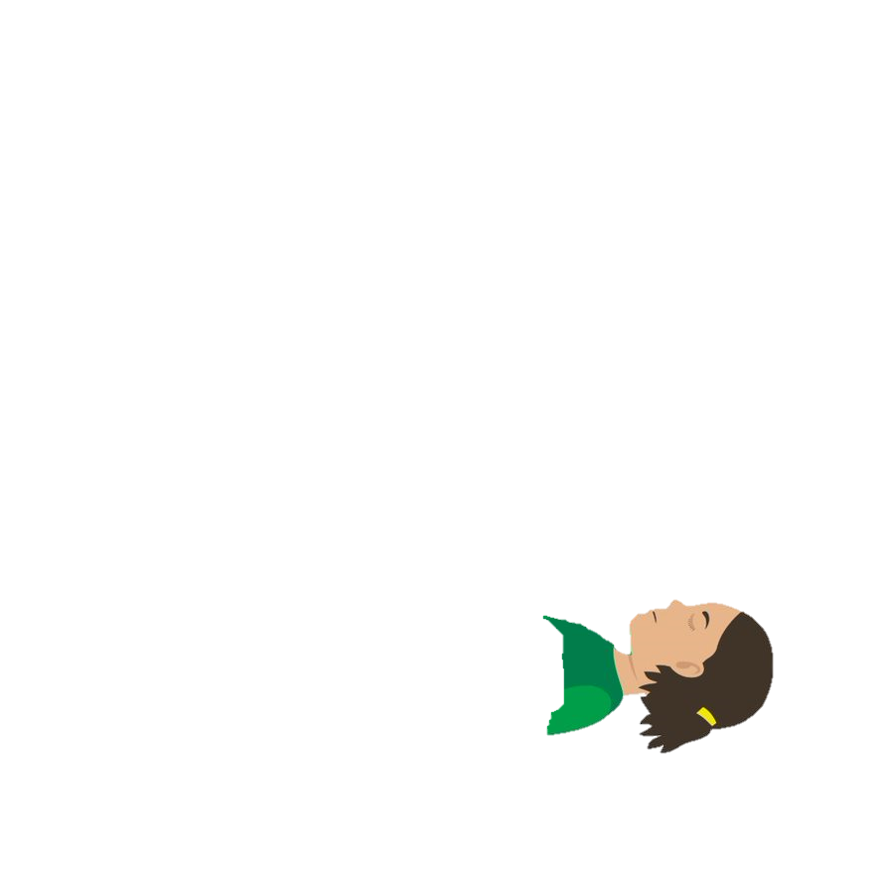

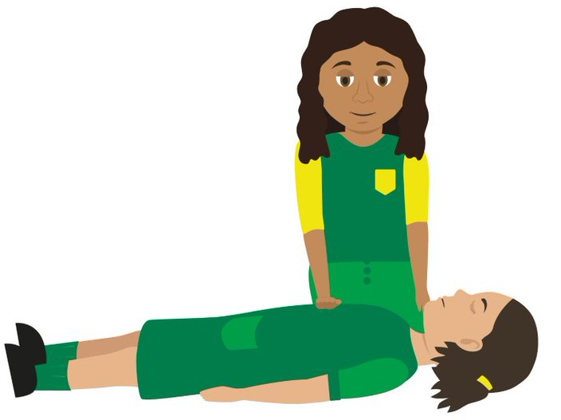

Your turn: CPR
1. If you find someone collapsed, you should first perform a primary survey. Do not place your face close to theirs.
If you have established from this that they are unresponsive and not breathing, you should ask a helper to call 999 or 112 for emergency help while you start CPR. Ask a helper to find and bring a defibrillator, if available.
Ask your helper to put the phone on speaker and hold it out towards you, so they can maintain a 2m distance.
If you are on your own, use the hands-free speaker on a phone so you can start CPR while speaking to ambulance control.
Do not leave the casualty to look for a defibrillator yourself. The ambulance will bring one.
2. Before you start CPR, use a towel or piece of clothing and lay it over the mouth and nose of the casualty.
Start CPR. Kneel by the casualty and put the heel of your hand on the middle of their chest. Put your other hand on top of the first. Interlock your fingers making sure they don't touch the ribs.
Keep your arms straight and lean over the casualty. Press down hard, to a depth of about 5-6cm before releasing the pressure, allowing the chest to come back up.
The beat of the song "Staying Alive" can help you keep the right speed
Do not give rescue breaths.
3. Continue to perform CPR until:
emergency help arrives and takes over
the person starts showing signs of life and starts to breathe normally
you are too exhausted to continue (if there is a helper, you can change over every one-to-two minutes, with minimal interruptions to chest compressions)
a defibrillator is ready to be used.
4. If the helper returns with a defibrillator, ask them to switch it on and follow the voice prompts while you continue with CPR.
Wherever possible, the helper should keep a distance of 2m.
NEVER do this on someone if they are responsive! At this time please do not put your face next to theirs to check for breathing, instead only look carefully for the chest rising and falling. When giving CPR place a cloth over the face of the casualty
KS4 – Basic Life Support
Notes:
Stress NOT doing this on someone who is breathing normally

