Slide 1
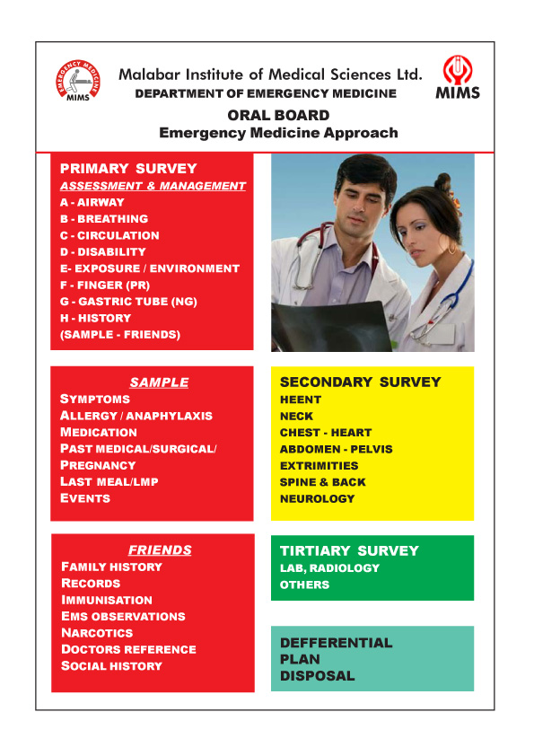
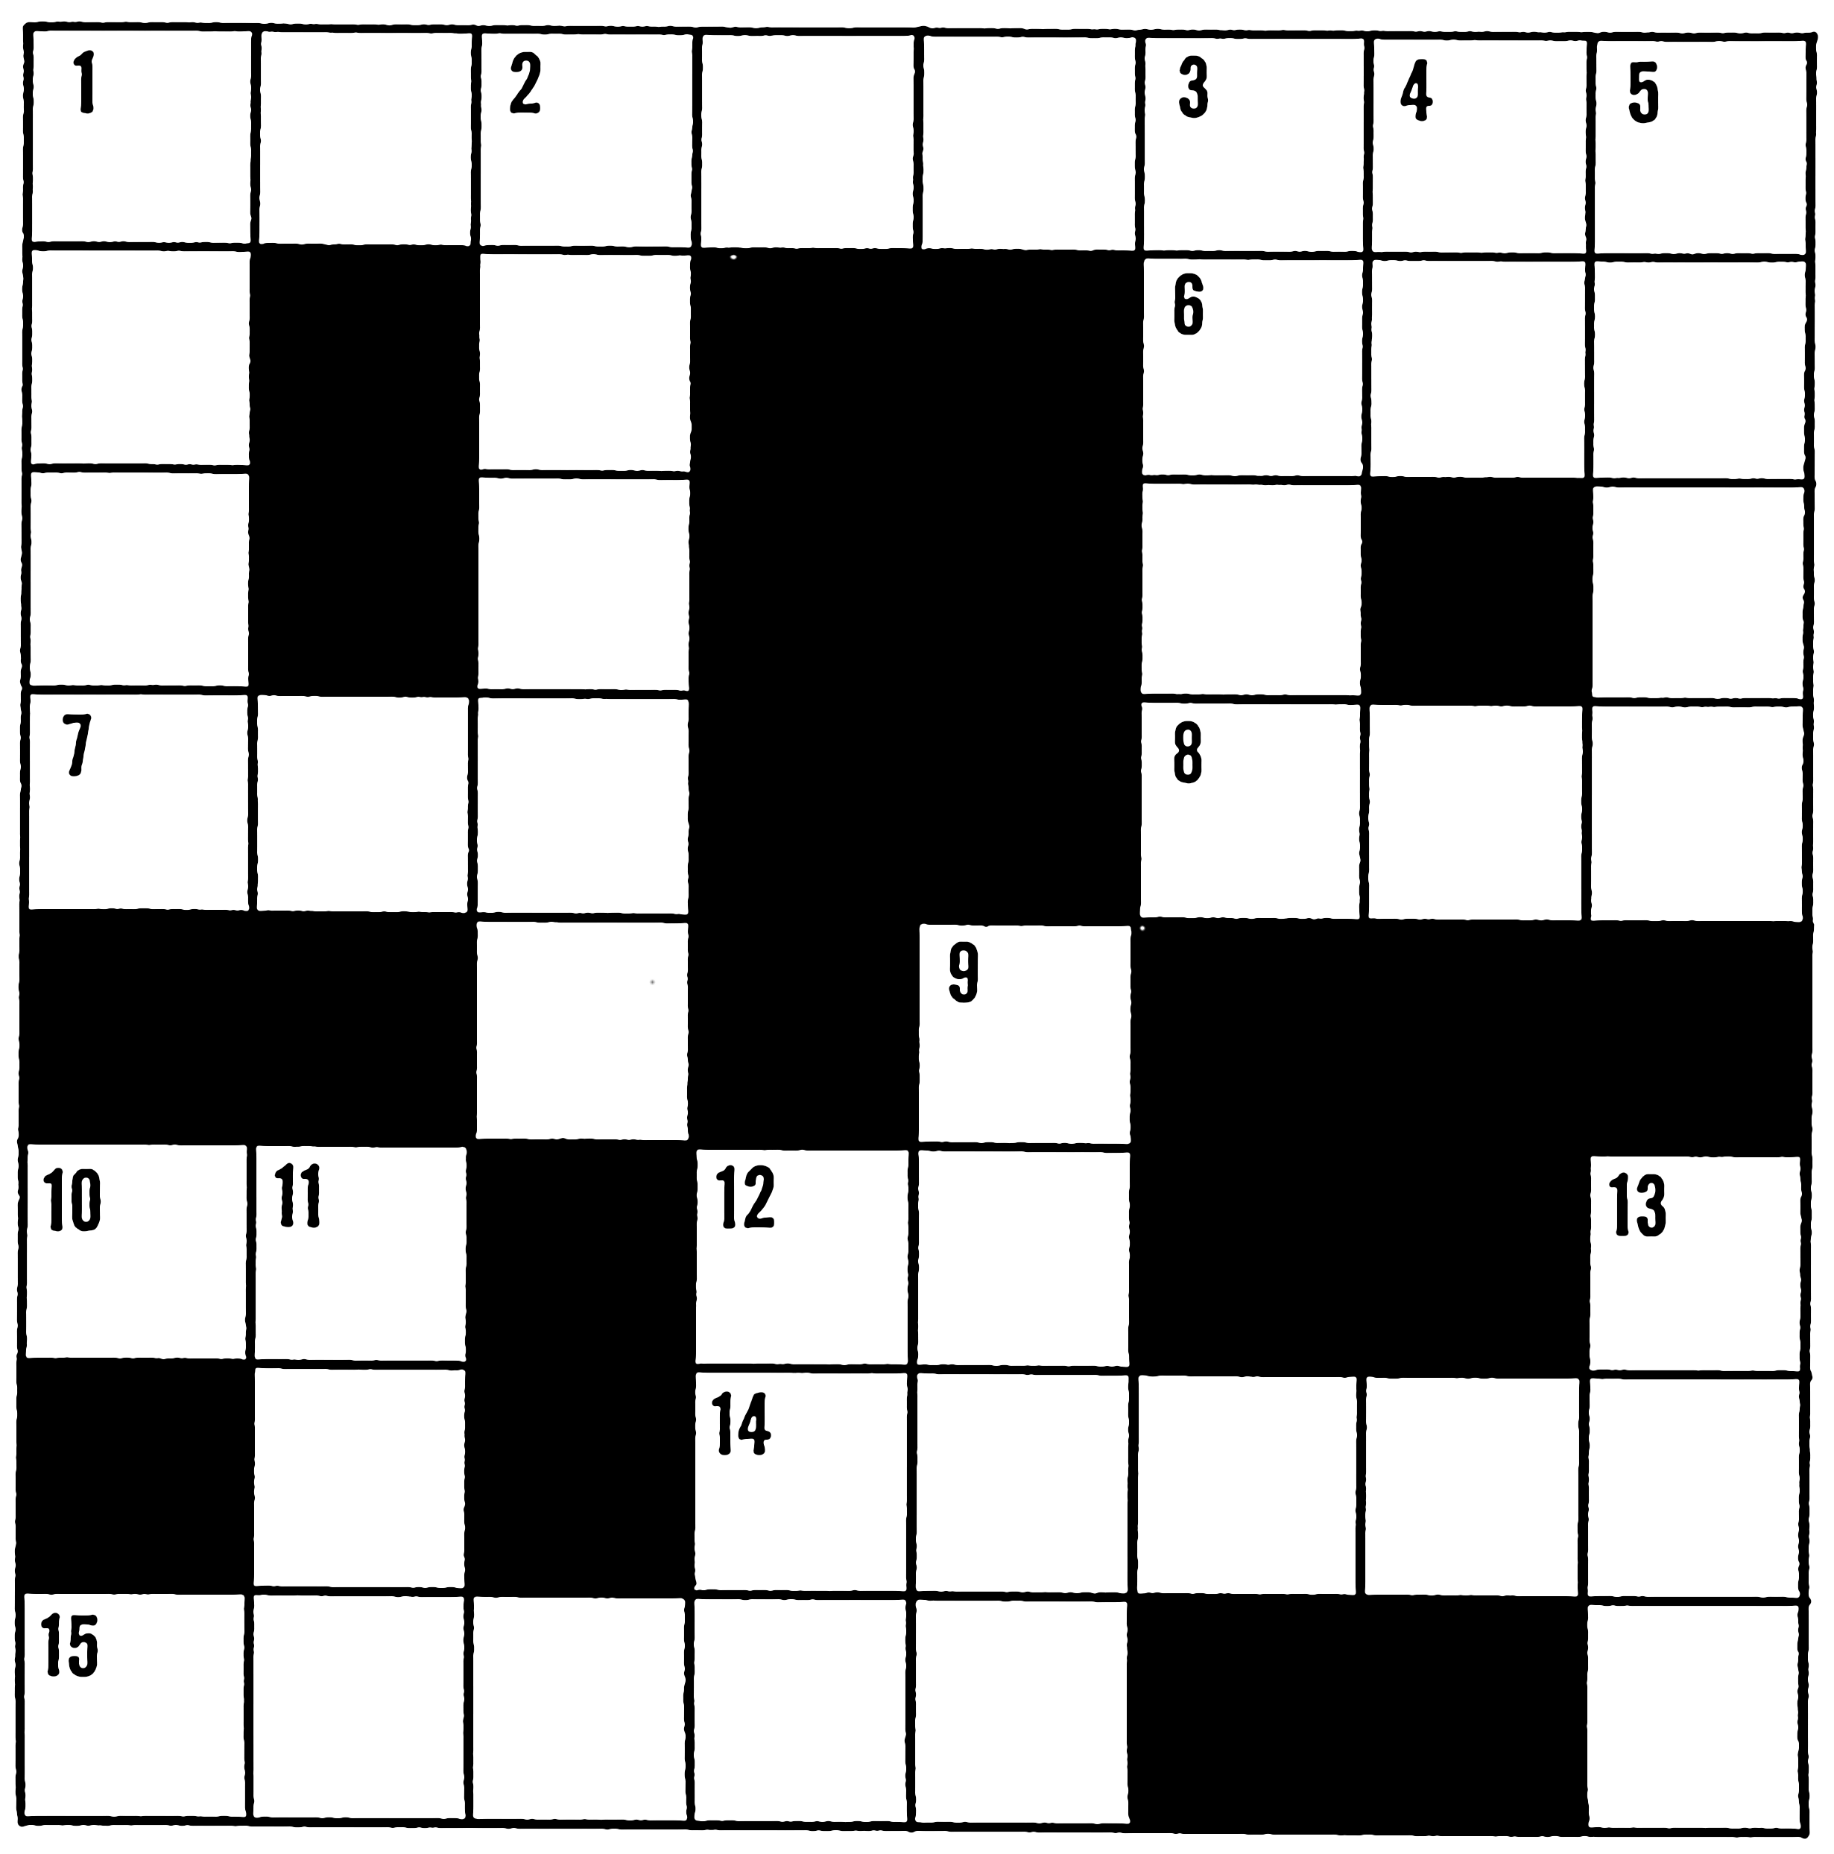
Asthma Optional activity
Your choice
Create a story board that shows an event where you need to deliver first aid to someone having an allergic reaction.
Design a poster that gives information on how to treat a casualty having an allergic reaction.
Create a crossword puzzle with a minimum of ten clues for your classmates that is linked to the topic of allergic reaction.
Design an information leaflet that explains common triggers and how to recognise symptoms.

