Slide 1
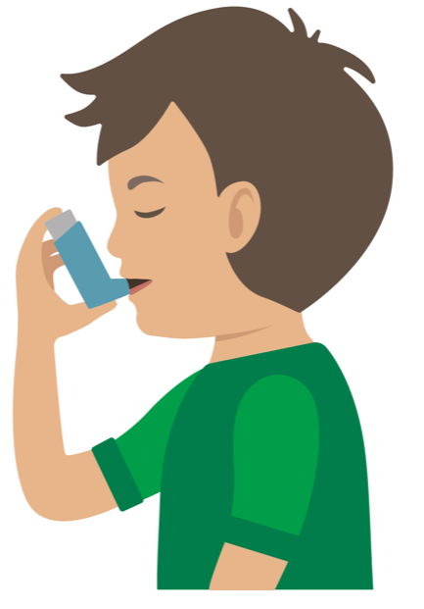

Your turn
Asthma attack
Reassure the casualty
Sit them up
If it’s the casualty’s first ever asthma attack then call 999/112 immediately
Assist them with a dose of their reliever inhaler (usually blue)
Using a spacer if they have one every 30 to 60 seconds, up to a maximum of 10 puffs
Encourage the casualty to breathe slowly and deeply
Maximum 10 puffs
Encourage them to find a sitting position they feel comfortable with
3. If attack does not ease after they have had 10 puffs of inhaler, or if their condition does not improve then call 999/112 for an ambulance
4. If the ambulance has not arrived within 15 mins, repeat step 2
If the casualty improves and you do not need to call 999/112, advise the patient to get a same day appointment to see their GP or asthma nurse
Remember: Your casualty could become unresponsive. Be prepared to perform CPR.
Notes:
In pairs/ small group demo management of an asthma attack

