Slide 1
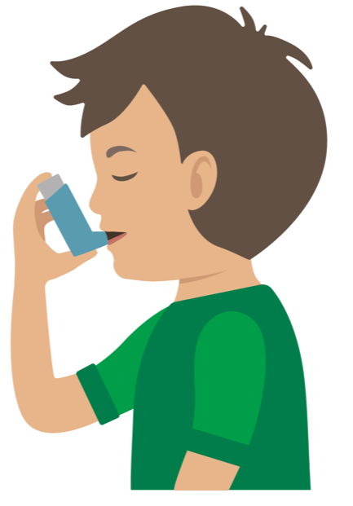


Starter Activity
Asthma Attack
Use your current first aid knowledge to explain what you could do for each of the 4 steps.
Step 1.
Step 2.
Help the c_ _ _ _ _ _ to s_ _ down
R_ _ _ _ _ _ _ them
Encourage s_ _ _ b_ _ _ _ _ _
Assist them to use their reliever inhaler
Casualty can take o_ _ or t_ _ puffs every t_ _ minutes
Maximum _ _ puffs
A mild attack should e_ _ _ in a few
m_ _ _ _ _ _
Step 3.
Step 4.
Call _ _ _ or _ _ _ if attack is not e_ _ _ _ _
Reassure casualty
S_ _ _ with them until the
a_ _ _ _ _ _ _ _ arrives
Remember: Your casualty could become unresponsive. Be prepared to perform CPR.
Notes:
Complete the storyboard to dmeosntrate knowledge at start of session- then revisit at the end of session

Slide 2
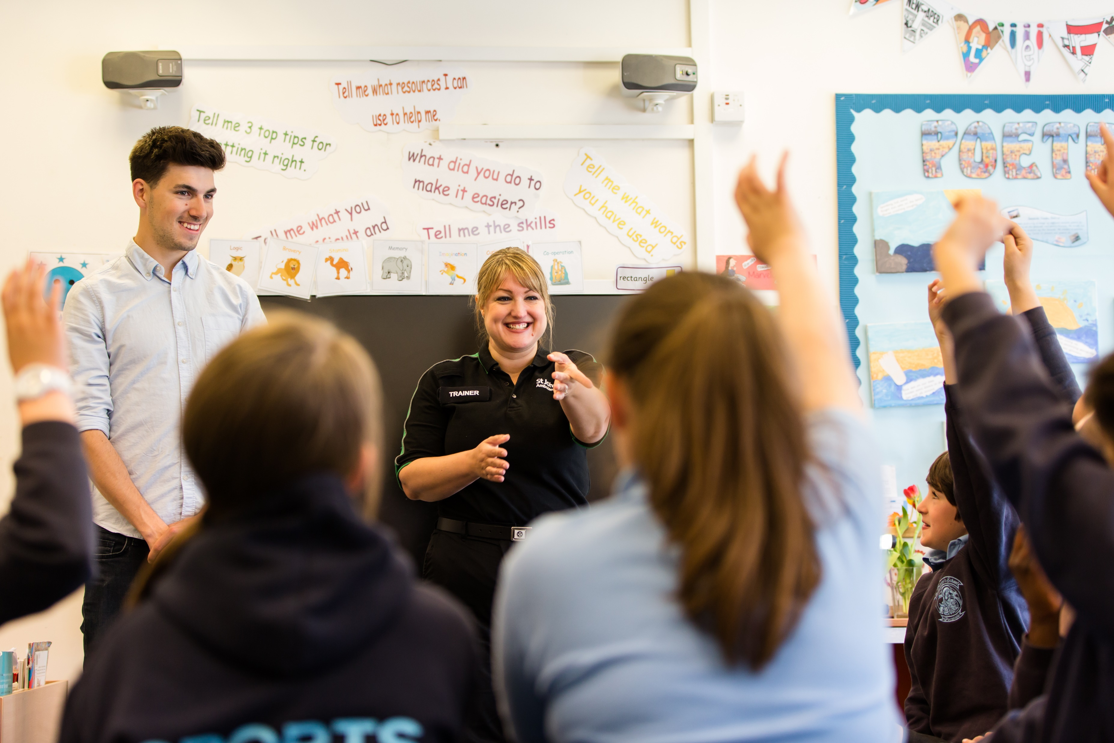


Asthma

Slide 3

Asthma
A short course to learn how to help someone who is having difficulty breathing due to asthma.
KS3 - Asthma

Slide 4
Learning outcomes
I can identify a casualty who is having an asthma attack.
I can provide first aid to a casualty who is having difficulty breathing due to asthma.
I know how and when to seek medical help for a casualty who is having an asthma attack.
Notes:
Teacher should refer to ground rules for the session at this stage

Slide 5
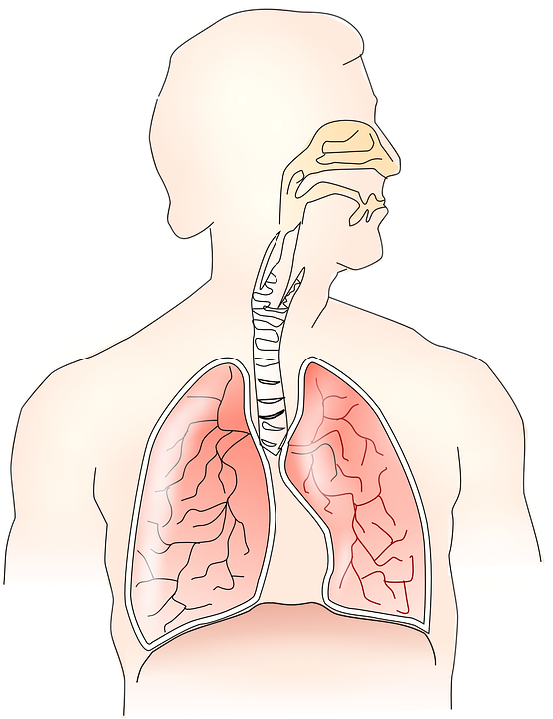
Asthma
Basic anatomy:
We breathe air into our body through our MOUTH and N_ _ _.
This air needs to travel down into our LUNGS.
During an A_ _ _ _ _ attack the muscles of the air passages can go into spasm and this causes the passages to N_ _ _ _ _ which makes breathing difficult.
Sometimes there is a “trigger” that can cause this to happen.
Notes:
ANSWERS; NOSE, ASTHMA, NARROW.
Explain trigger is something that sets off an asthma attack.
Note optional activity A29 could fit in here

Slide 6

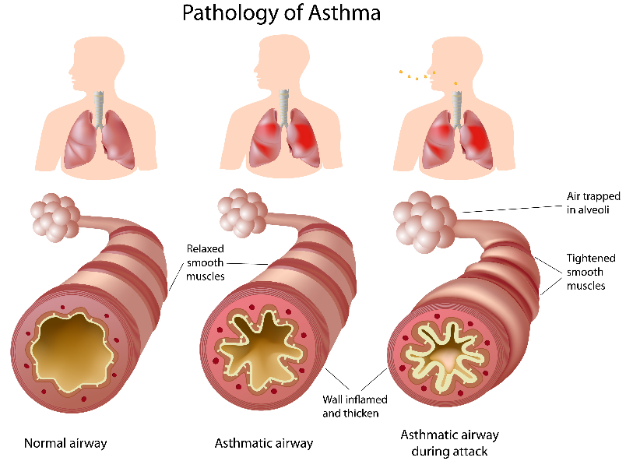
What do you see?
Asthma
Notes:
To note is the narrowing of the airways in the asthma airway. Explain breathe in through mouth and nose and air goes down into lungs where it gives body the oxygen it needs to survive. Asthma airways are congested with mucous etc and make it narrow and harder to breathe.

Slide 7
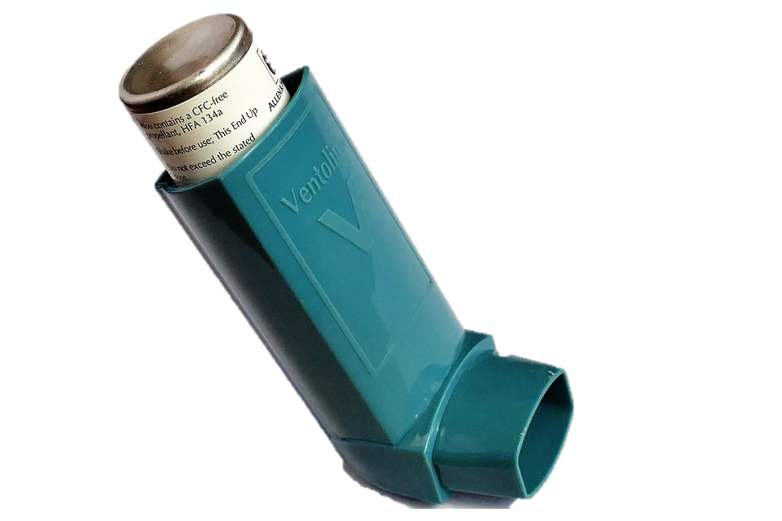
Activity A9
Group work
QUESTION:
Describe how it may feel when someone is having difficulty breathing
QUESTION:
What could a first aider do to help someone who is having an asthma attack?
BONUS QUESTION A9a:
What are possible triggers for an asthma attack? (something that makes an asthma attack happen)
Notes:
Triggers: pet hair, cold air, exercise, pollution, cigarette smoke, allergy etc

Slide 8
Asthma triggers
A9a
How many of these answers did you get?
Pollen
Pollutions
12
13
Pet fur
Aerosols
22
Smoking
23
11
Exercise
Cold Air
15
23
Cleaning solutions
Total:
19
Notes:
Optional maths activity - this list of triggers is not exhaustive. Students can add more.

Slide 9

What do you think?
A SIGN is something you can see.
Signs and symptoms of someone having an asthma attack could be…
A SYMPTOM is something that the casualty can feel.
Notes:
Write answers onto white board ready for next slide to compare.
Option to add to to these answers after watching the video

Slide 10
Answers
Signs and symptoms of asthma could be:
Difficulty breathing
Wheezing
Difficulty speaking, leading to short sentences and wheezing
Coughing
Distress and anxiety
Grey/blue tinge to lips
Exhaustion
Loss of responsiveness
Panic
Rapid heart rate
Question:
What action should be taken if somebody is displaying these signs or symptoms?
Explain your answer.

Slide 11
Watch this video
ASTHMA
KS3 – Asthma

Slide 12
Your turn
Asthma attack
Reassure the casualty
Sit them up
If it’s the casualty’s first ever asthma attack then call 999/112 immediately
Assist them with a dose of their reliever inhaler (usually blue)
Using a spacer if they have one every 30 to 60 seconds, up to a maximum of 10 puffs
Encourage the casualty to breathe slowly and deeply
Maximum 10 puffs
Encourage them to find a sitting position they feel comfortable with
3. If attack does not ease after they have had 10 puffs of inhaler, or if their condition does not improve then call 999/112 for an ambulance
4. If the ambulance has not arrived within 15 mins, repeat step 2
If the casualty improves and you do not need to call 999/112, advise the patient to get a same day appointment to see their GP or asthma nurse
Remember: Your casualty could become unresponsive. Be prepared to perform CPR.
Notes:
In pairs/ small group demo management of an asthma attack

Slide 13


Role play
John invites his friend from school to have dinner at his house.
After dinner, she is sitting a chair and begins to wheeze.
She tells John that she is asthmatic and has noticed John has two cats in the house. She is beginning to become anxious and her talking is being effected as she is finding it difficult to talk in full sentences.
What should John do next?
Notes:
Ensure that the first aider would remove the casualty from the “trigger”- in this case the cat.

Slide 14
Activity A28
This activity provides students with the opportunity to answer the questions on our asthma quiz . If you wish to complete this please use our downloadable quiz sheet found on the St John Ambulance website.

Slide 15

Casualty care
Pause for thought...
Which actions do you think are most important when caring for a casualty?
Get help
No food or drink
Prevent condition worsening
Remain calm
Keep warm
Treat with dignity and respect
Reassure casualty
Communicate well
Notes:
Opportunity to discuss common casualty care skills which are necessary in all first aid situations.

Slide 16



Check your learning
I am able to:
Identify when someone is having difficulty breathing due to asthma.
Give first aid to a casualty who is having an asthma attack.
Call for help correctly, if it is necessary.
YES UNSURE NO

Slide 17
Check your knowledge
Asthma attack
Revisit the starter activity (first slide in this presentation).using a coloured pen can you....
1. Add more detail to your previous answers?
2. Make any corrections?
Notes:
Note this activity emulates what it is like to breathe through a narrow airway (similar to asthma)

Slide 18

Information and support
If any of the content in this session has upset or concerned you please discuss this with one of the teachers at your school
Further support can be found at:
www.childline.org.uk
www.youngminds.org.uk
www.samaritans.org
Further information linked to first aid can be found at:
www.sja.org.uk
www.asthma.org.uk

Slide 19

Thank you!

Slide 20
Optional Activity A29
The respiratory system
This extension activity tasks the students with bringing to life the respiratory system. They can use the pictures provided, or use their own research, to help make their own model of how oxygen travels around the human body. Use our downloadable worksheet which can be found on the St John Ambulance website.

