Slide 1

Your turn: Severe bleeds
Tick the box if you can successfully complete the key step…
1. Put on gloves
2. Apply pressure to the wound
(but only if there is nothing stuck in it)
3. Apply a dressing to the wound
the pad goes over the injury
use bandage to secure it in place
make sure the bandage is not too tight
call 999/112
4. Apply second dressing, if needed
no more than two dressings at a time
5. If an object is in the wound, do NOT remove it
put a pad on either side of the object
bandage carefully over the pads without pushing the object in any further

Slide 2
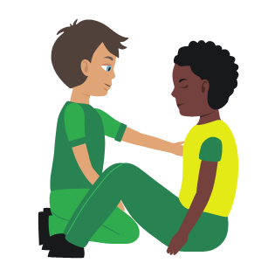
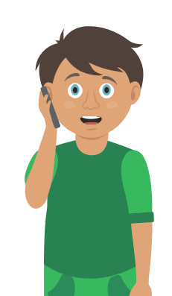
Your turn: Nosebleed
Tick the box if you can successfully complete the key step…
1. Sit
the casualty down leaning forward
2. Ask
them to pinch the soft part of their nose for 10 minutes
3. Check
if the bleeding has stopped
if still bleeding pinch nose for a further 10 minutes
4. Recheck
if still bleeding pinch for a further 10 minutes
5. Help
if bleeding has not stopped after a maximum of 30 minutes seek medical help

Slide 3
Your turn: Dealing with shock
Tick the box if you can successfully complete the key step…
1. Treat
any injuries that may have caused shock
2. Help
the casualty to sit down, then lie down
3. Raise
and support the casualty’s legs if possible
4. Call
999/112
5. Reassure
them and loosen any tight clothing
6. Keep
the casualty warm

