Slide 1

Starter Activity
Severe Bleeding
Use your current first aid knowledge to explain what you could do for each of the 5 steps.
Step 1.
Step 2.
Step 3.
Put on g_ _ _ _ _
Apply p_ _ _ _ _ _ _ to the wound
(but only if there is nothing stuck in it)
Apply a d_ _ _ _ _ _ _ to the wound
the pad goes o_ _ _ the injury
use b_ _ _ _ _ _ to secure it in place
make sure the bandage
is not t_ _ t_ _ _ _
call _ _ _ /112
Step 4.
Step 5.
Apply s_ _ _ _ _ dressing, if needed
n_ m_ _ _ than two dressings at a time
If an object is in the wound, D_ N _ _ remove it
put a pad on either side of the
o_ _ _ _ _
bandage carefully o_ _ _ the pads without p_ _ _ _ _ _ the object in any further

Slide 2
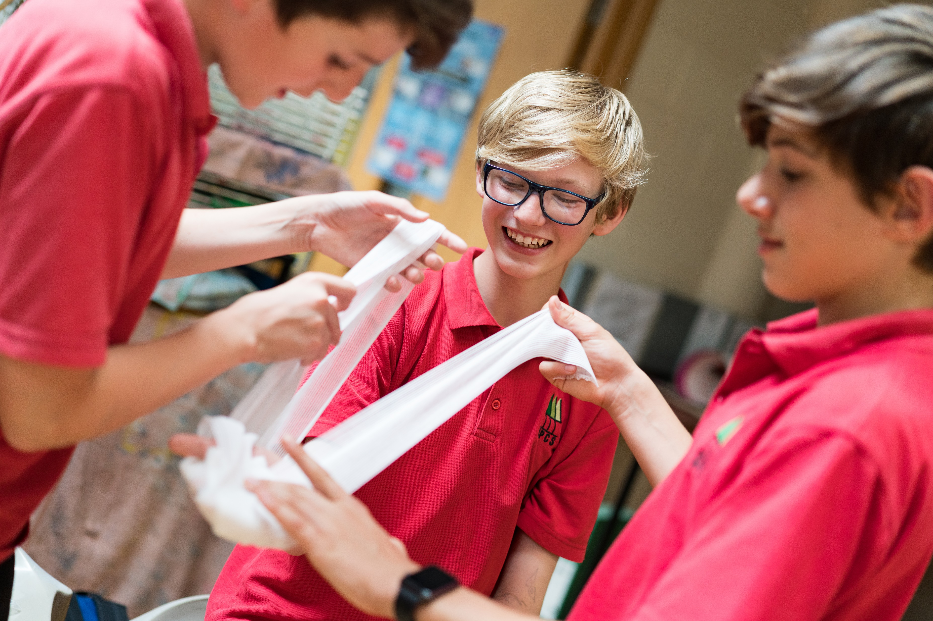


Bleeding
KS3 - Bleeding

Slide 3


Bleeding
A short course to learn how to help someone who is bleeding.

Slide 4
Learning outcomes
I can describe the signs and symptoms of internal and external bleeding
I can assess and provide first aid to a casualty who is bleeding
I can seek medical help if required for a casualty who is bleeding
Notes:
Teacher should refer to ground rules for the session at this stage

Slide 5
Blood starter activity
Have a guess…
  What percentage of the human body is made up of blood?
  Does your blood contain gold?
  How many kilometres would an adult's blood vessels stretch if they were laid out in a single line?
  Is all blood red?
  How many litres of blood are in an average adult?
  Does blood keep us warm or cool?
Notes:
Blood makes up approx. 7% of the human body.
YES there is gold within your blood! Approx. 0.2 milligrams in an adult’s body (a TINY amount).
AN adults blood vessels would stretch to approx. 1,600 KM
NO – snails, lobsters and spiders have BLUE blood.
An average adult has 4.5 – 5.5 litres of blood inside them.
YES! It does both!

Slide 6
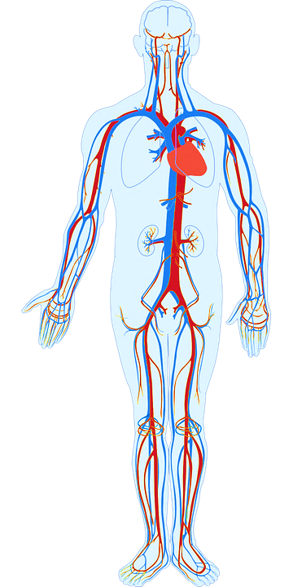
Blood
Basic anatomy:
Blood contains lots of different things and circulates around inside our body. It provides our body with the things we need to survive.
The H_ _ _ _ pumps blood around the body.
Blood travels around the body inside of blood
V_ _ _ _ _ _ which are all different sizes. These are called arteries, veins and capillaries.
Notes:
A: Heart
B. Vessels

Slide 7
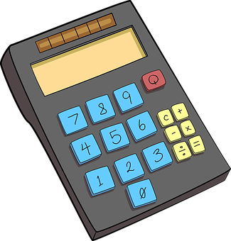
Blood mathematics A7
In small groups use the worksheet to complete the pie chart and learn about the contents of our blood.

Slide 8

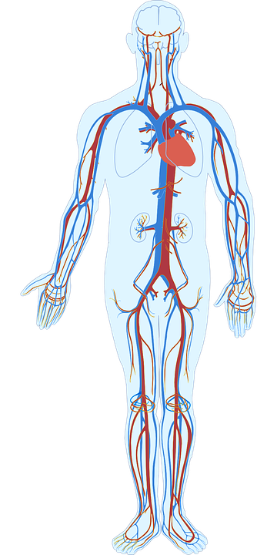


What do you see?
Notes:
To note is the colour of the blood flow.
Red is blood that is rich in oxygen travelling FROM the heart. Blue is the blood that is carrying CO2 back to the lungs to be expelled (exhaled) and re oxygenated. It is a closed complex system. Any interruption to this (e.g. blood loss - injury) causes issues as organs may not then receive the oxygen they need to survive and keep our body functions stable.

Slide 9

What do you think?
A SIGN is something you can see.
Signs and symptoms of someone who is bleeding could be…
A SYMPTOM is something that the casualty can feel.
Notes:
Write answers onto white board ready for next slide to compare.

Slide 10
Answers
Signs and symptoms of someone with an internal or external bleed could be:
pale, clammy, cold skin
rapid pulse/heart beat
rapid breathing/shortness of breath
feeling dizzy
distress and anxiety
grey/blue tinge to the lips
bruising and pain at site of the injury
loss of responsiveness
Question:
What action might a person take if they saw somebody with these signs and symptoms?
Explain your answer.

Slide 11
Watch this video (warning content contains scenes of bleeding)
SEVERE BLEED

Slide 12
Your turn: Severe bleeds
1. Put on gloves
2. Apply pressure to the wound
(but only if there is nothing stuck in it)
3. Apply a dressing to the wound
the pad goes over the injury
use bandage to secure it in place
make sure the bandage is not too tight
call 999/112
4. Apply second dressing, if needed
no more than two dressings at a time
5. If an object is in the wound, do NOT remove
put a pad on either side of the object
bandage carefully over the pads without pushing the object in any further
Notes:
Scenario cards are available which the teacher can use to make the practical activity relevant in a certain context for students.

Slide 13
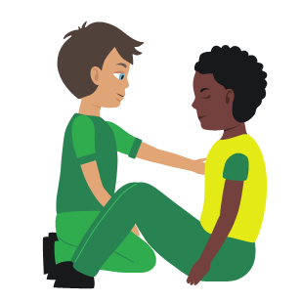
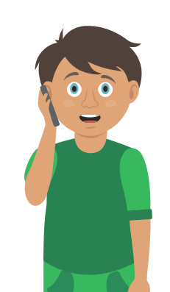
Your turn: Nosebleed
1. Sit
the casualty down leaning forward
2. Ask
them to pinch the soft part of their nose for 10 minutes
3. Check
if the bleeding has stopped
if still bleeding pinch nose for a further 10 minutes
5. Help
if bleeding has not stopped after a maximum of 30 minutes seek medical help
4. Recheck
if still bleeding pinch for a further 10 minutes
Notes:
Scenario cards are available which the teacher can use to make the practical activity relevant in a certain context for students.

Slide 14
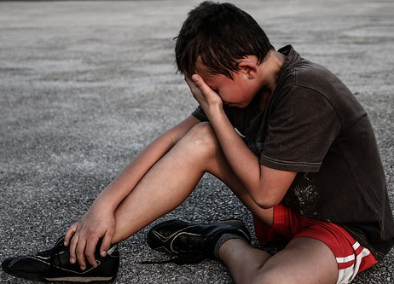

Activity
Group work
QUESTION:
How might a casualty feel if injured and bleeding?
QUESTION:
What could a first aider wear (if it is possible) when dealing with someone who is bleeding? Why?
QUESTION:
What should a first aider do straight away when they see someone who is bleeding?
Notes:
Q1 discuss, sad, afraid, scared, anxious, dizzy, shocked etc
Q2 gloves- hygiene and infection control
Q3….next slide

Slide 15

Answers
Reassure
Positioning
Pressure
Primary survey
Call for help
Be alert for shock
Immobilise
Notes:
Check answers to confirm learning from video and session content
Key learning points are reassure, immobilise, pressure, be alert for shock, positioning and call for help.

Slide 16
Shock
What is shock?
Shock is a life-threatening medical condition which is caused by a lack of blood flow to tissues and organs in the body.
The decreased blood flow means there is a lack of oxygen to the organs, this can lead to tissue damage. Shock requires quick treatment to prevent organ failure.
Signs and symptoms of someone suffering from shock could be:
Rapid, shallow breathing
Cold, clammy skin
Rapid, weak pulse
Dizziness or fainting
Weakness
Sweating
Chest pain

Slide 17
Watch this video
SHOCK

Slide 18
Your turn: Dealing with shock
1 Treat
any injuries that may have caused shock
2 Help
the casualty to sit down, then lie down
3 Raise
and support the casualty’s legs if possible
4 Call
999/112
5 Reassure
them and loosen any tight clothing
6 Keep
the casualty warm
Notes:
Scenario cards are available which the teacher can use to make the practical activity relevant in a certain context for students.

Slide 19

Key words
Definitions….
Veins
Plasma
Capillaries
Red blood cells
Platelets
Arteries
Heart rate
White blood cells
Circulation
Shock

Slide 20
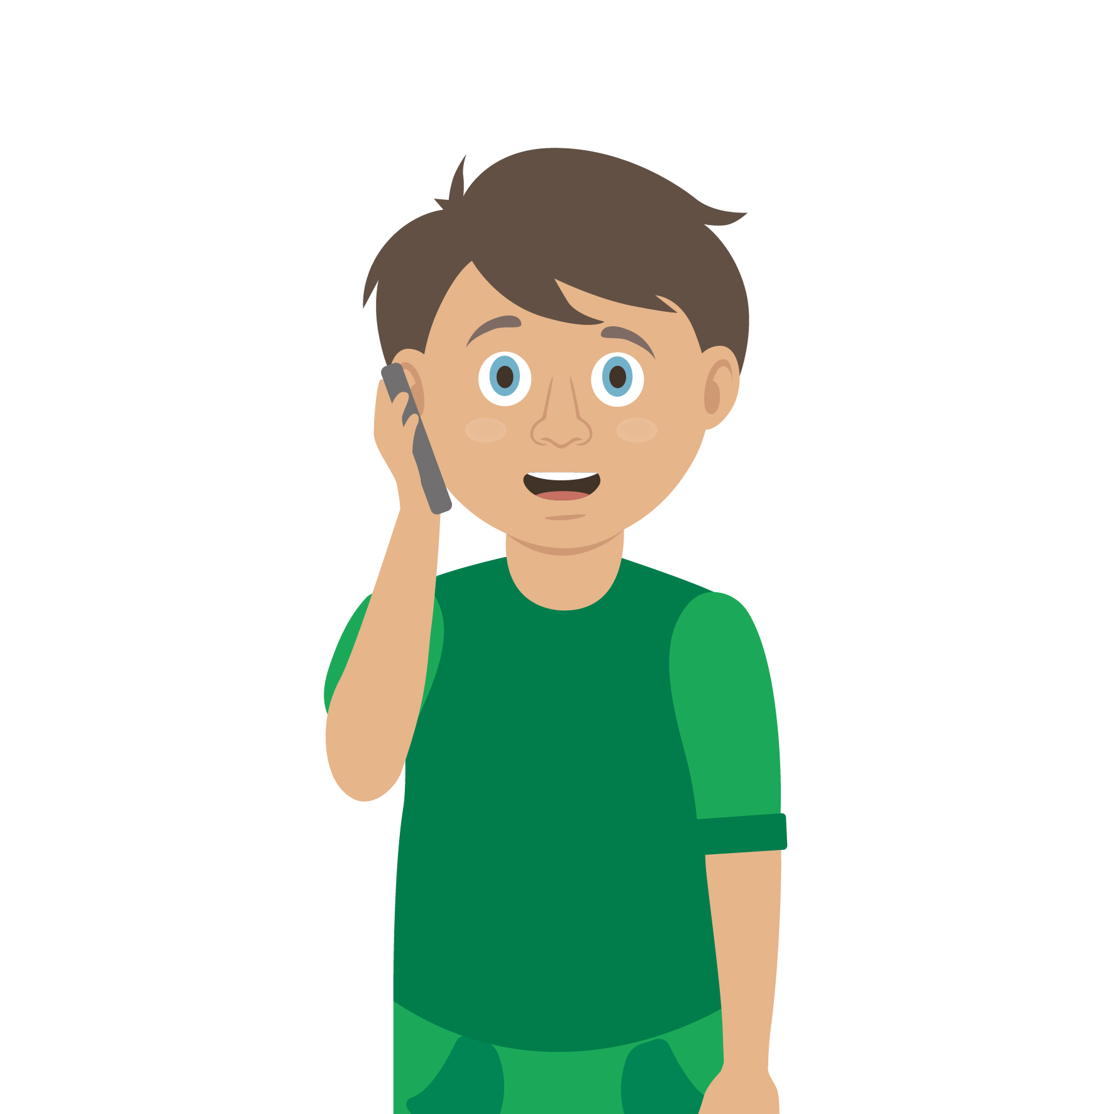
Casualty care
Pause for thought...
Which actions do you think are most important when caring for a casualty?
Get help
No food or drink
Prevent condition worsening
Remain calm
Keep warm
Treat with dignity and respect
Reassure casualty
Communicate well
Notes:
Opportunity to discuss common casualty care skills which are necessary in all first aid situations.

Slide 21



Check your learning
I am able to:
Identify when someone is bleeding
Give first aid to a casualty who is bleeding
Call for help correctly, if it is necessary
YES UNSURE NO

Slide 22

Check your knowledge
Severe bleeding
Revisit the starter activity on the first slide of this presentation. Using a coloured pen can you....
1. Add more detail to your previous answers?
2. Make any corrections?

Slide 23

Information and support
If any of the content in this session has upset or concerned you please discuss this with one of the teachers at your school
Further support can be found at:
www.childline.org.uk
www.youngminds.org.uk
www.samaritans.org
Further information linked to first aid can be found at:
www.sja.org.uk
www.asthma.org.uk

Slide 24

Thank you!

Slide 25
Blood mathematics A7
In small groups use the worksheet to complete the pie chart and learn about the contents of our blood.

Slide 26
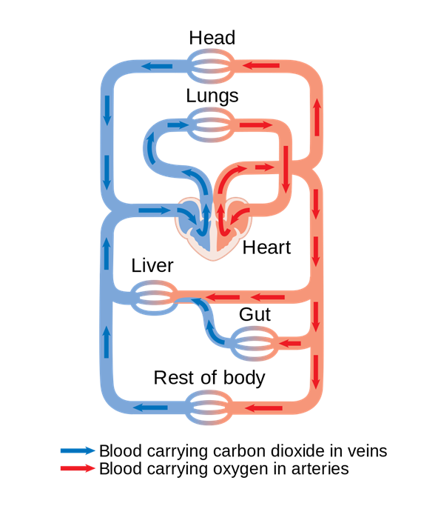
Optional activity A38
Circulatory system
This extension activity tasks the students with creating a model of the circulatory system; they can use research or the pictures provided to help.
Use our downloadable worksheet which can be found on the St John Ambulance website.

Slide 27
Activity A5
Let’s make blood
Students now have the opportunity to create a model of our blood. Students will learn about basic blood content and the function of blood. Use our downloadable worksheet which can be found on the St John Ambulance website.

Slide 28
Activity A11
Make a stethoscope
Students now have the opportunity to construct a basic stethoscope. They can listen to each other’s hearts and learn how a real stethoscope works. Use our downloadable worksheet which can be found on the St John Ambulance website.
Notes:
Quite a basic modelling activity but used in conjunction with noting heart rate increases after exertion etc can be useful

Slide 29
Watch this video (warning content contains scenes of bleeding)
MINOR BLEED: NOSEBLEED
KS3 – Bleeding
Notes:
NOTE*** please ensure students are ok to watch scenes where blood is present***

