Slide 1
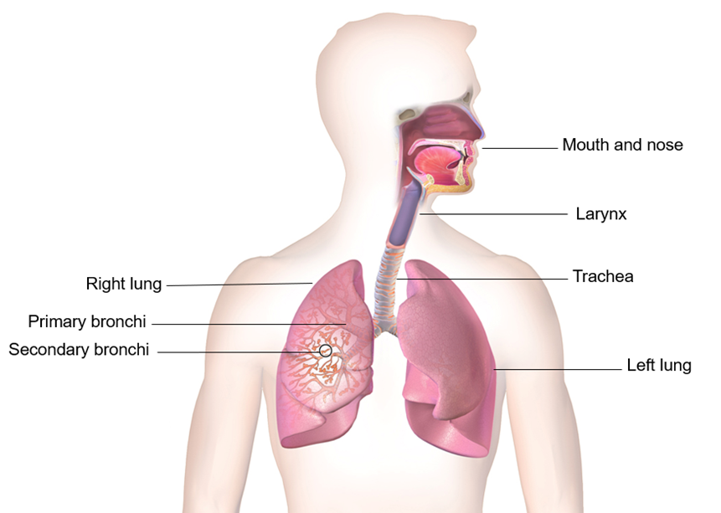
Activity A39
Be creative
Students now have the option to draw a diagram on flip chart paper that demonstrates the passage of air and food. Use the diagram to explain and label how choking may occur, research or use the slides within this presentation to help with this task.

