Slide 1
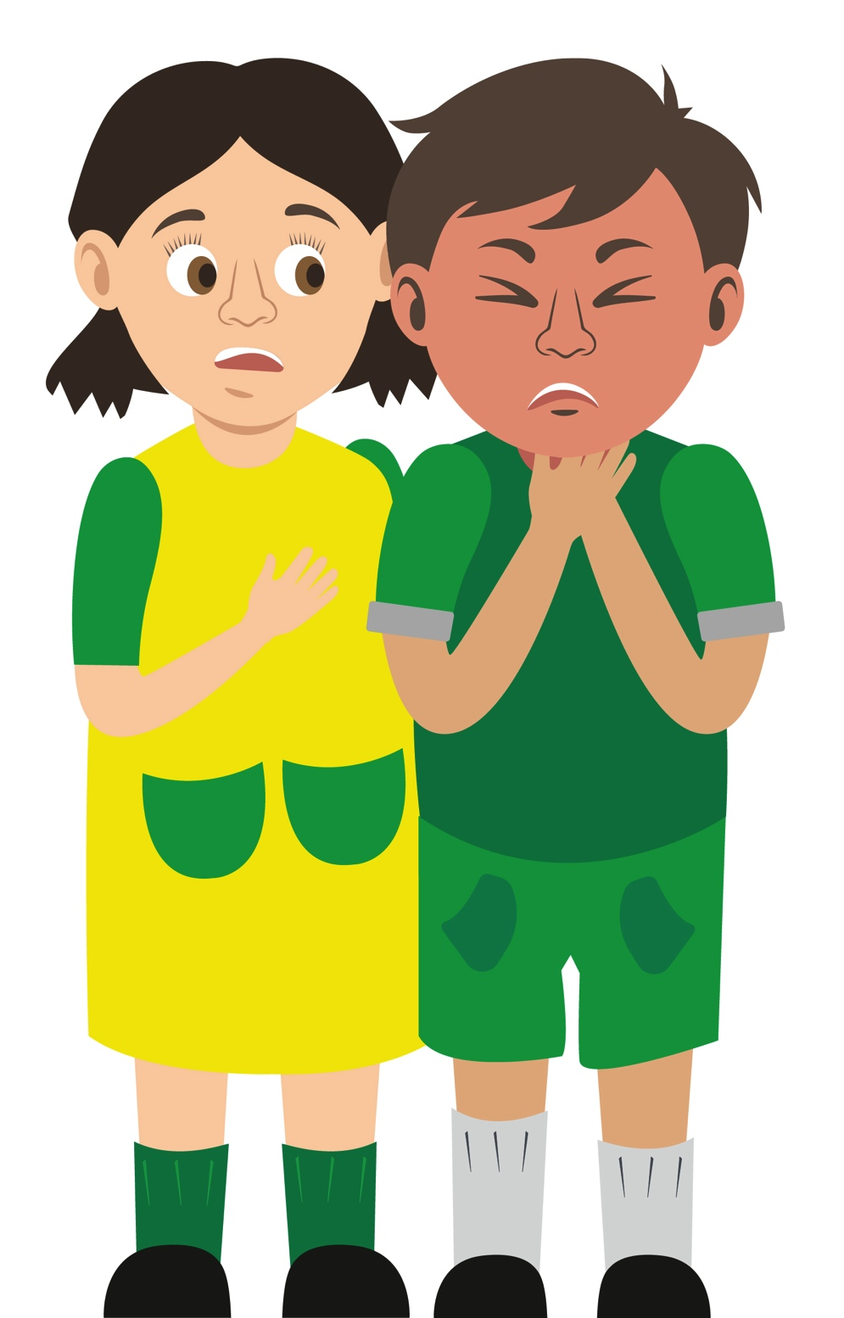
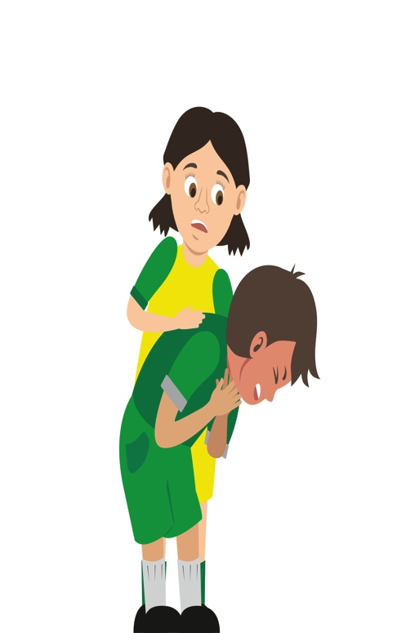
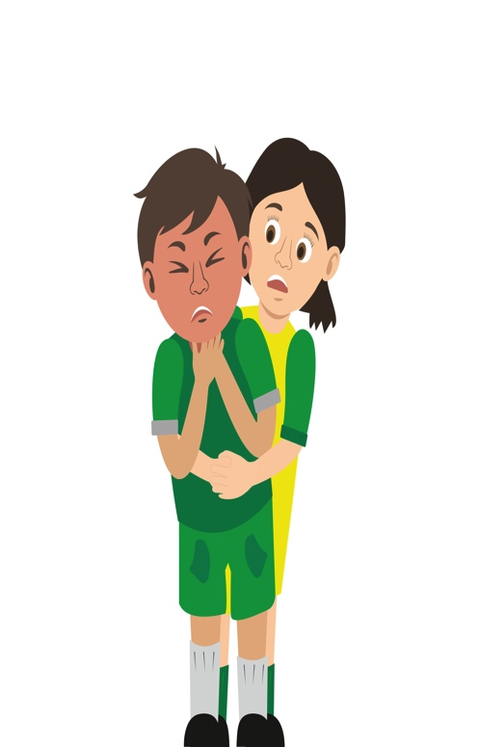

Your turn: Choking
Tick the box if you can successfully complete the key step…
1 Ask
‘Are you choking?’
2 Encourage
casualty to cough
3 Give
up to 5 back blows using the heel of your hand between their shoulder blades
4 Give
up to 5 ‘tummy’ thrusts (abdominal thrusts)
5 Help
if still choking call 999/112 for emergency help
6 Repeat the cycle if necessary
Remember: Your casualty could become unresponsive. Be prepared to perform CPR

