Slide 1
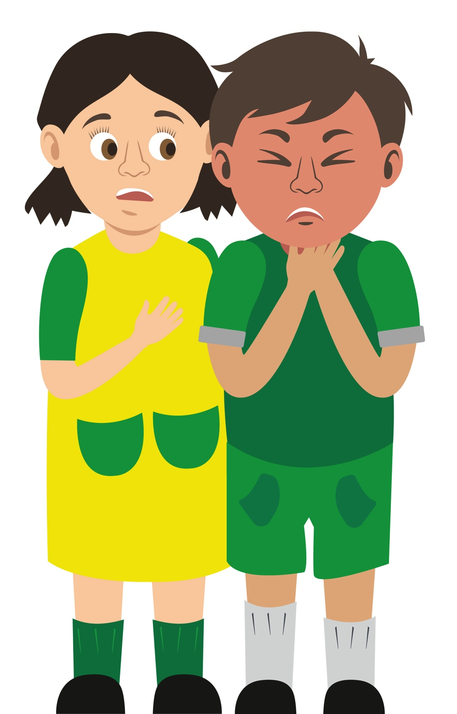
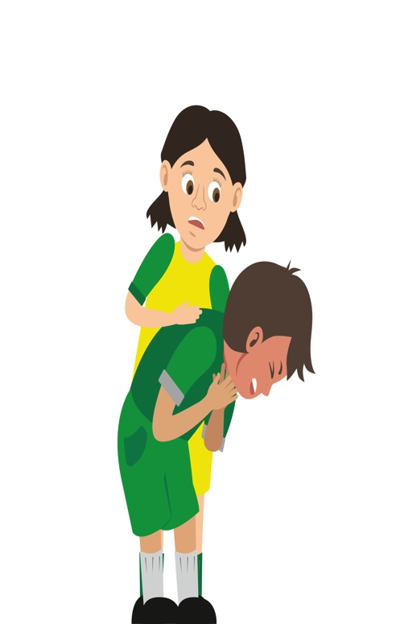
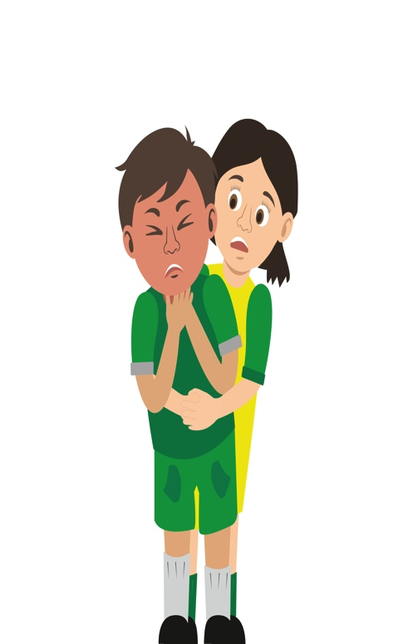

Starter Activity
Choking
Use your current first aid knowledge to explain what you could do for each of the 6 steps.
Step 1.
Step 2.
Step 3.
Ask
‘Are you c_ _ _ _ _ _?’
Encourage
casualty to c_ _ _ _
Give
up to 5 b_ _ _ b_ _ _ _ using the h_ _ _of your hand between their
s_ _ _ _ _ _ _ blades
Step 4.
Step 5.
Step 6.
Give
up to 5 ‘tummy’ thrusts (a_ _ _ _ _ _ _ _ thrusts)
Help
if still choking call _ _ _/112 for
e_ _ _ _ _ _ _ _ help
Repeat the cycle if necessary
Remember: Your casualty could become
u_ _ _ _ _ _ _ _ _ _e. Be prepared to perform _ _ _.
Notes:
Fill in spaces to check knowledge at start of session.
This should be revisited and amended or expanded at end of session.

Slide 2
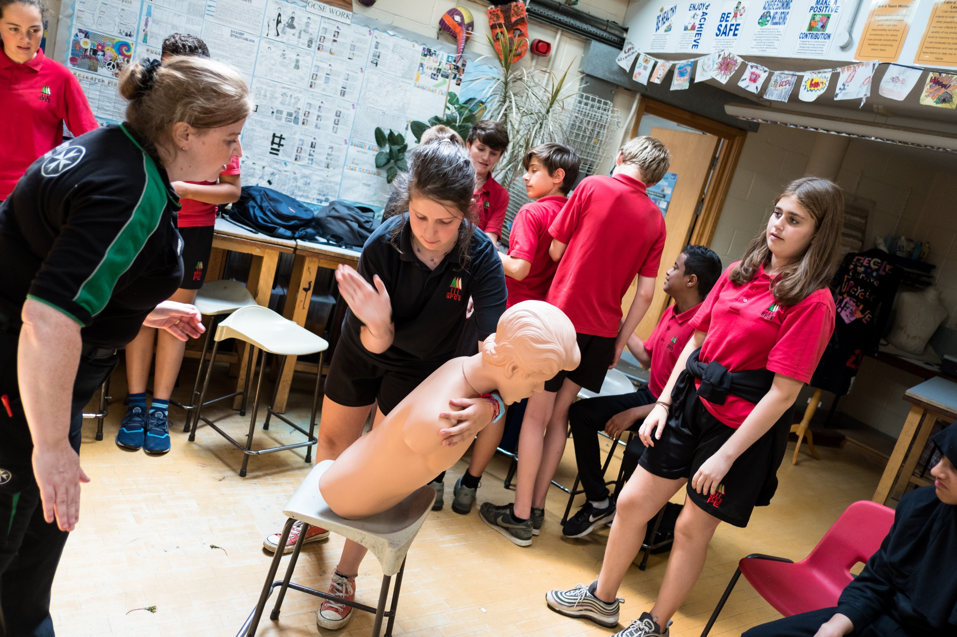


Choking
KS3 - Choking

Slide 3
Choking
A short course to learn how to help someone who is choking.

Slide 4
Learning outcomes
I am able to recognise when someone is choking
I know how to give first aid to a casualty who is choking
I am able to get help for a casualty who is choking
Notes:
Teacher should refer to ground rules for the session at this stage

Slide 5
Casualty care
Always talk to the casualty.
Listen carefully to what your casualty tells you.
Try to gather correct information before dialling 999 or 112 but if emergency help is needed dial 999 or 112 immediately'
Notes:
It should be noted that a casualty may not be able to communicate if they are choking but the first aider needs to be advised that they should always talk to the casualty and let them know what is happening

Slide 6
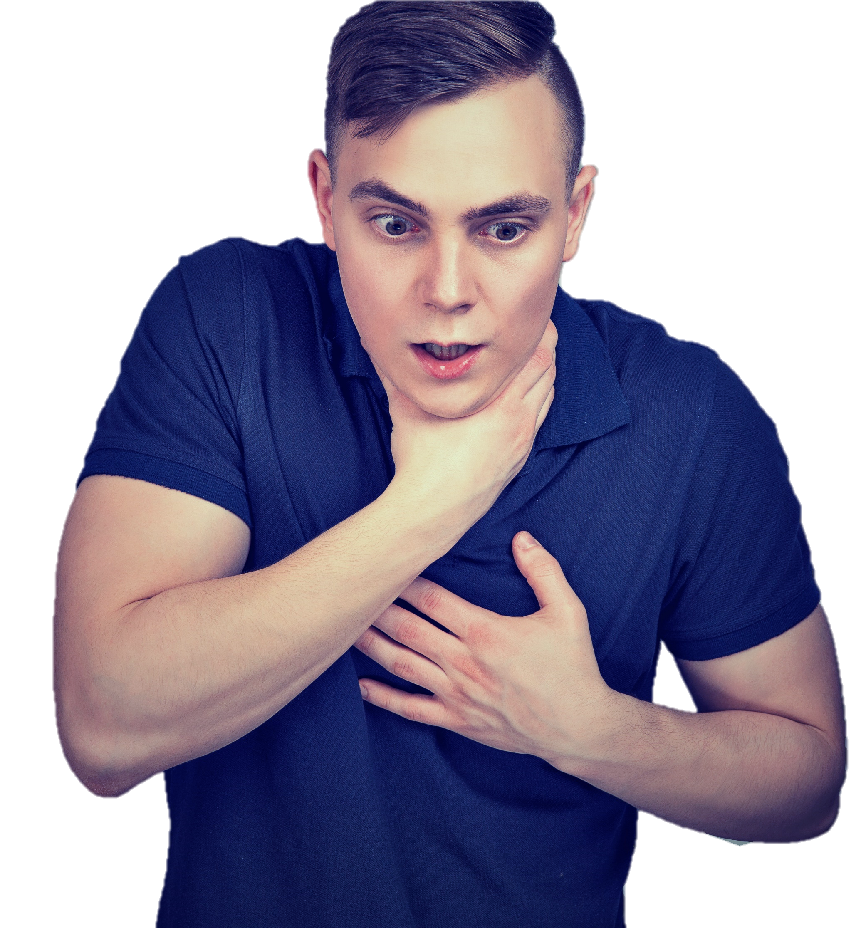
What’s wrong? A37
What is happening?
Why?
What are the symptoms of this?
What signs might you see?
How would the casualty be able to tell somebody what is wrong?
Notes:
Ask students to tell you what is happening – has it ever happened to them? Quick discussion
A SIGN is something you can see.
A SYMPTOM is something that the casualty can feel.

Slide 7
Signs and symptoms A37
How many of these answers did you get?
Wheezing/difficulty breathing
Unresponsive
25
21
Can’t speak
Grabbing throat
17
Coughing
21
Panicked
11
Face turning blue
14
Wide eyes
13
Total:
19
Notes:
Add up your scores from correct answers

Slide 8
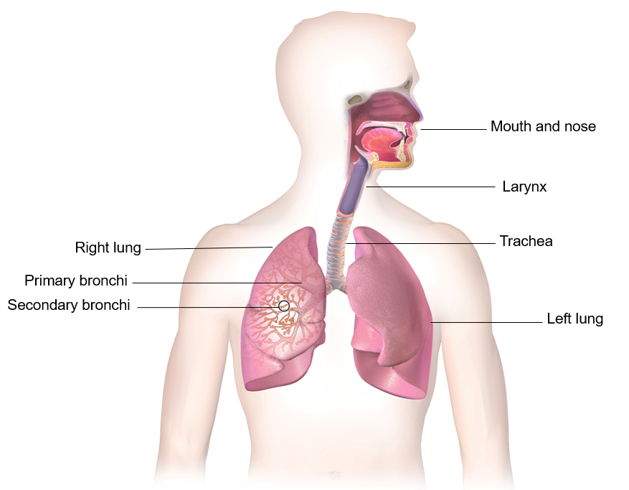
Anatomy of the airway
Breathe in and out:
Air enters the body through your mouth and nose.
Adult respiration rate is 14-20 times per minute.
The ribs protect the lungs.
S&C:
How many times would you breathe in and out in an hour/ full day if you breathe 15 times per minute?
Notes:
Answer = 15 x 60 (mins in an hour) = 900.
x 24 (hours in a day) = 21,600 times.

Slide 9
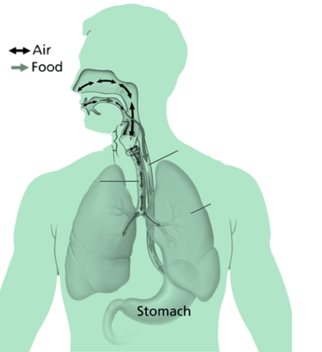
Passage of air and food
Epiglottis:
A flap in the throat that prevents food entering the windpipe
Trachea (windpipe) :
a cartilaginous tube that connects to the lungs
Is present in all air breathing animals
It allows the passage of air and extends from the larynx into the primary bronchi of the lungs
Oesophagus:
A muscular tube approx. 25 cm long
It connects the mouth to the stomach
The walls of the oesophagus contract to move the food along the tube into the stomach
Oesophagus
Left lung
Notes:
Explain that as we put food in our mouth, chew and swallow occasionally bits of food go into the airway instead of into the oesophagus.

Slide 10
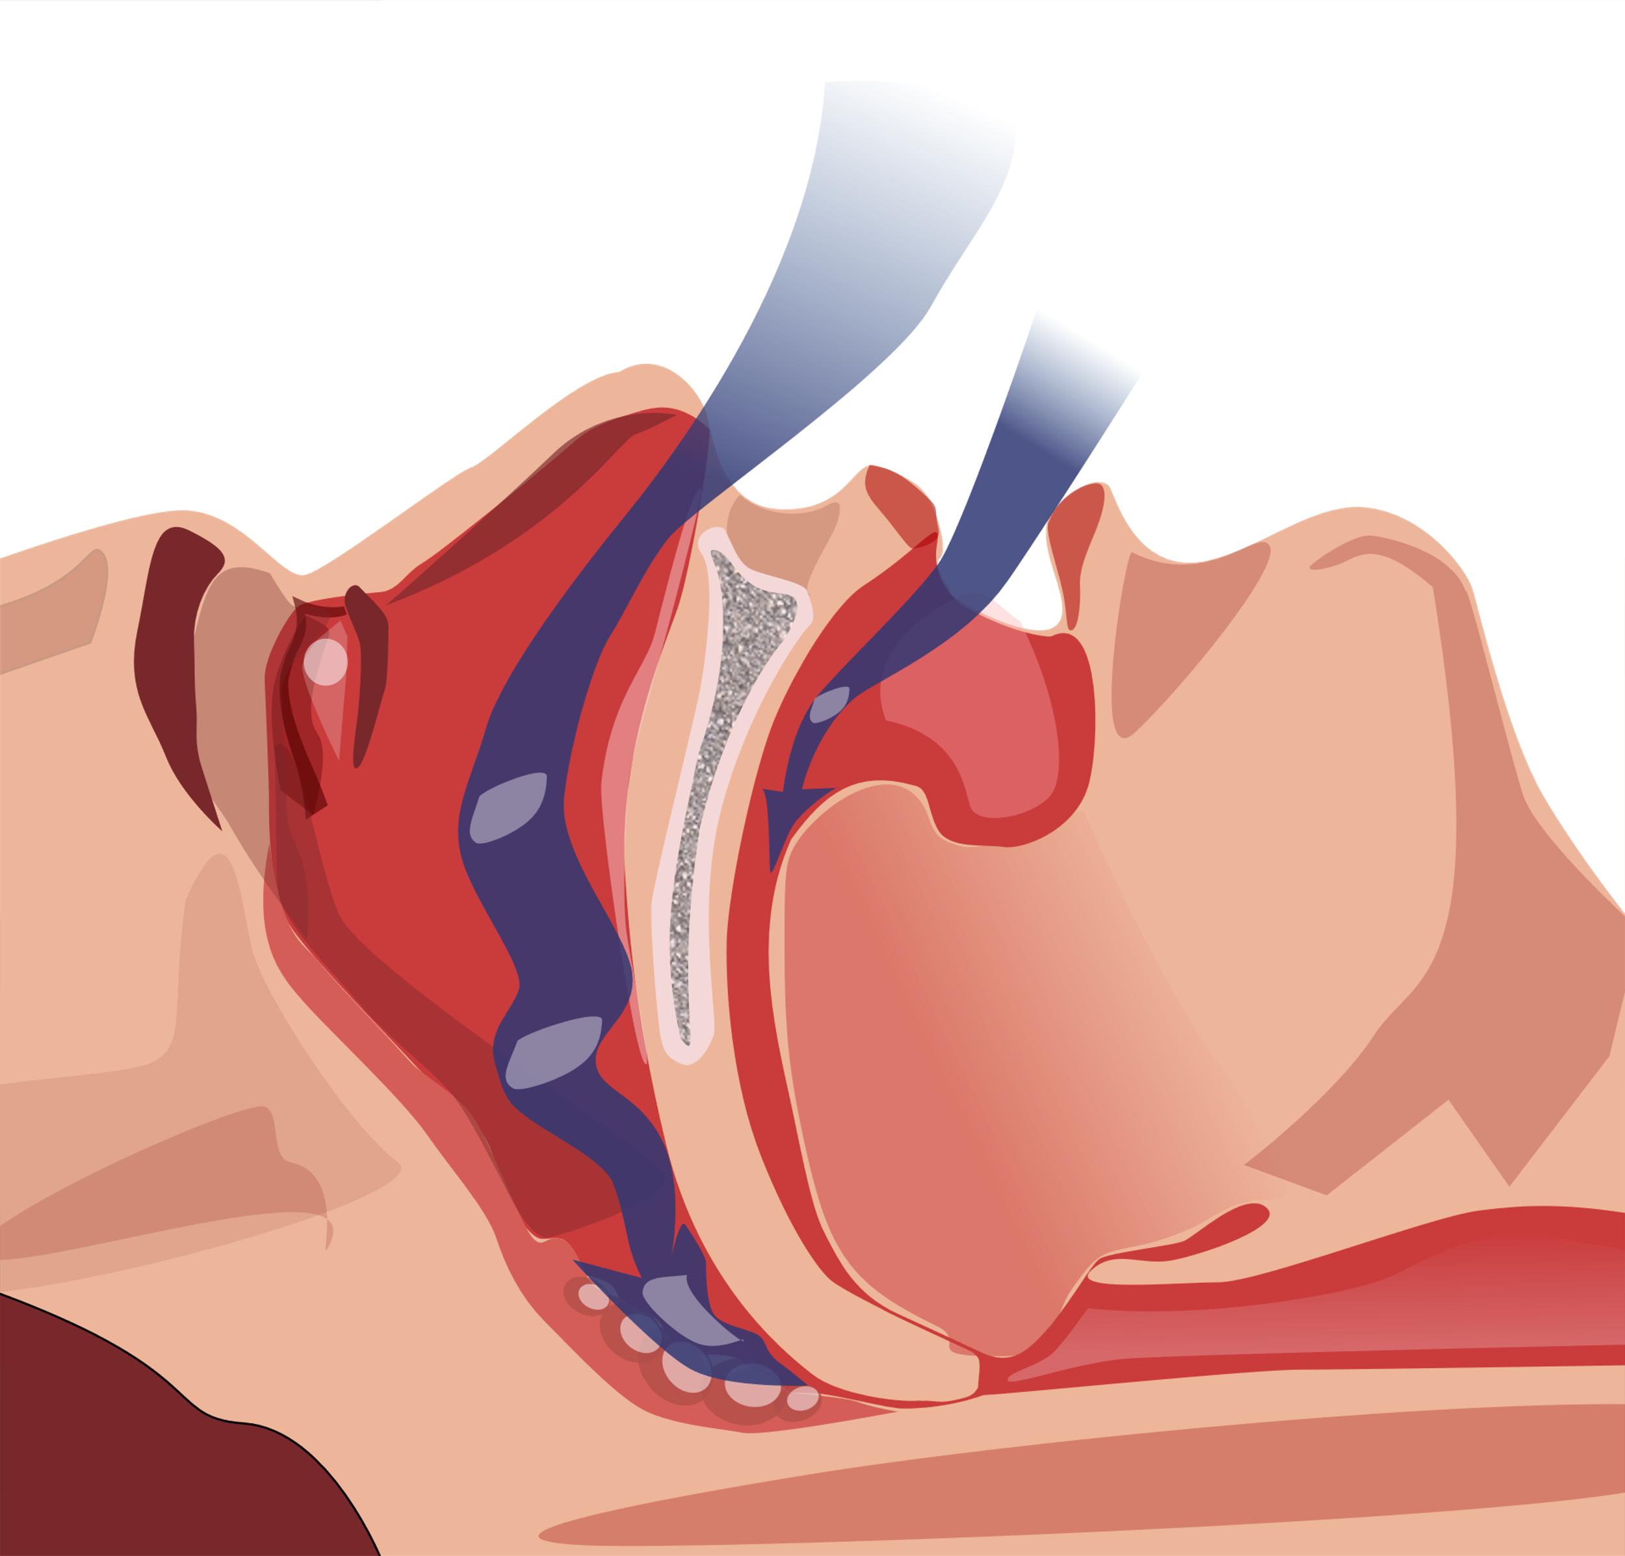
Airway emergencies
The airway could be blocked due to a restriction. This could be caused by tissues of the airway narrowing due to swelling brought on by allergies, burns etc.
The airway could be blocked due to an object – this is known as an obstruction. This could be food, foreign body or the tongue if the casualty is unresponsive.
Notes:
Ensure the students understand the difference between an obstruction and a restriction.

Slide 11
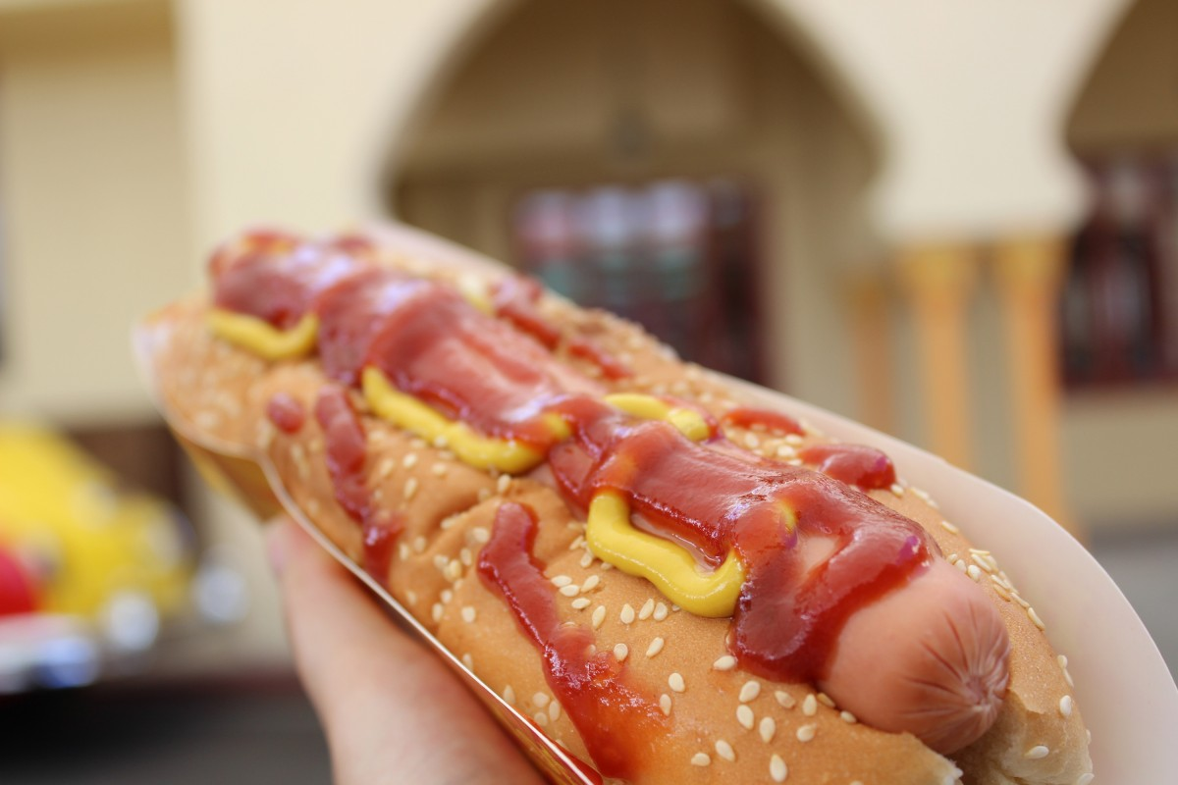
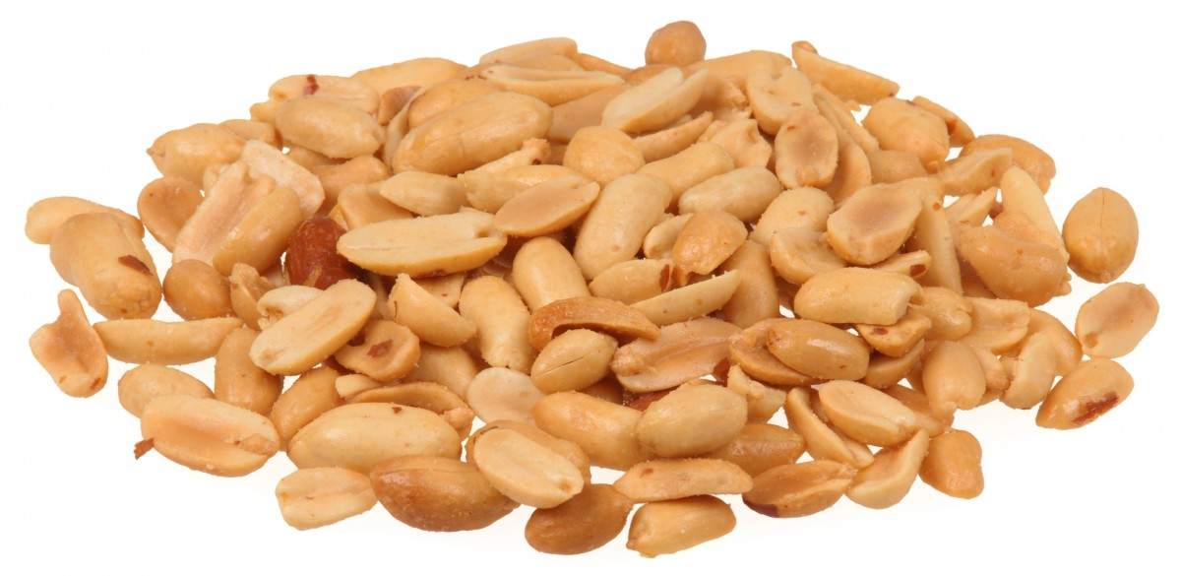
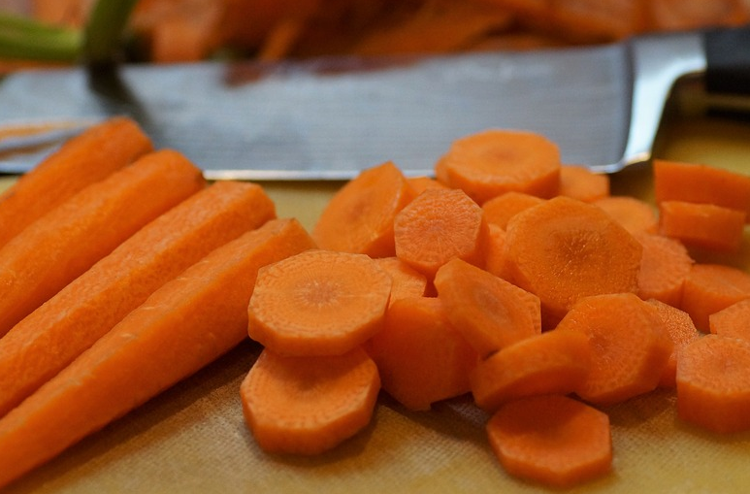
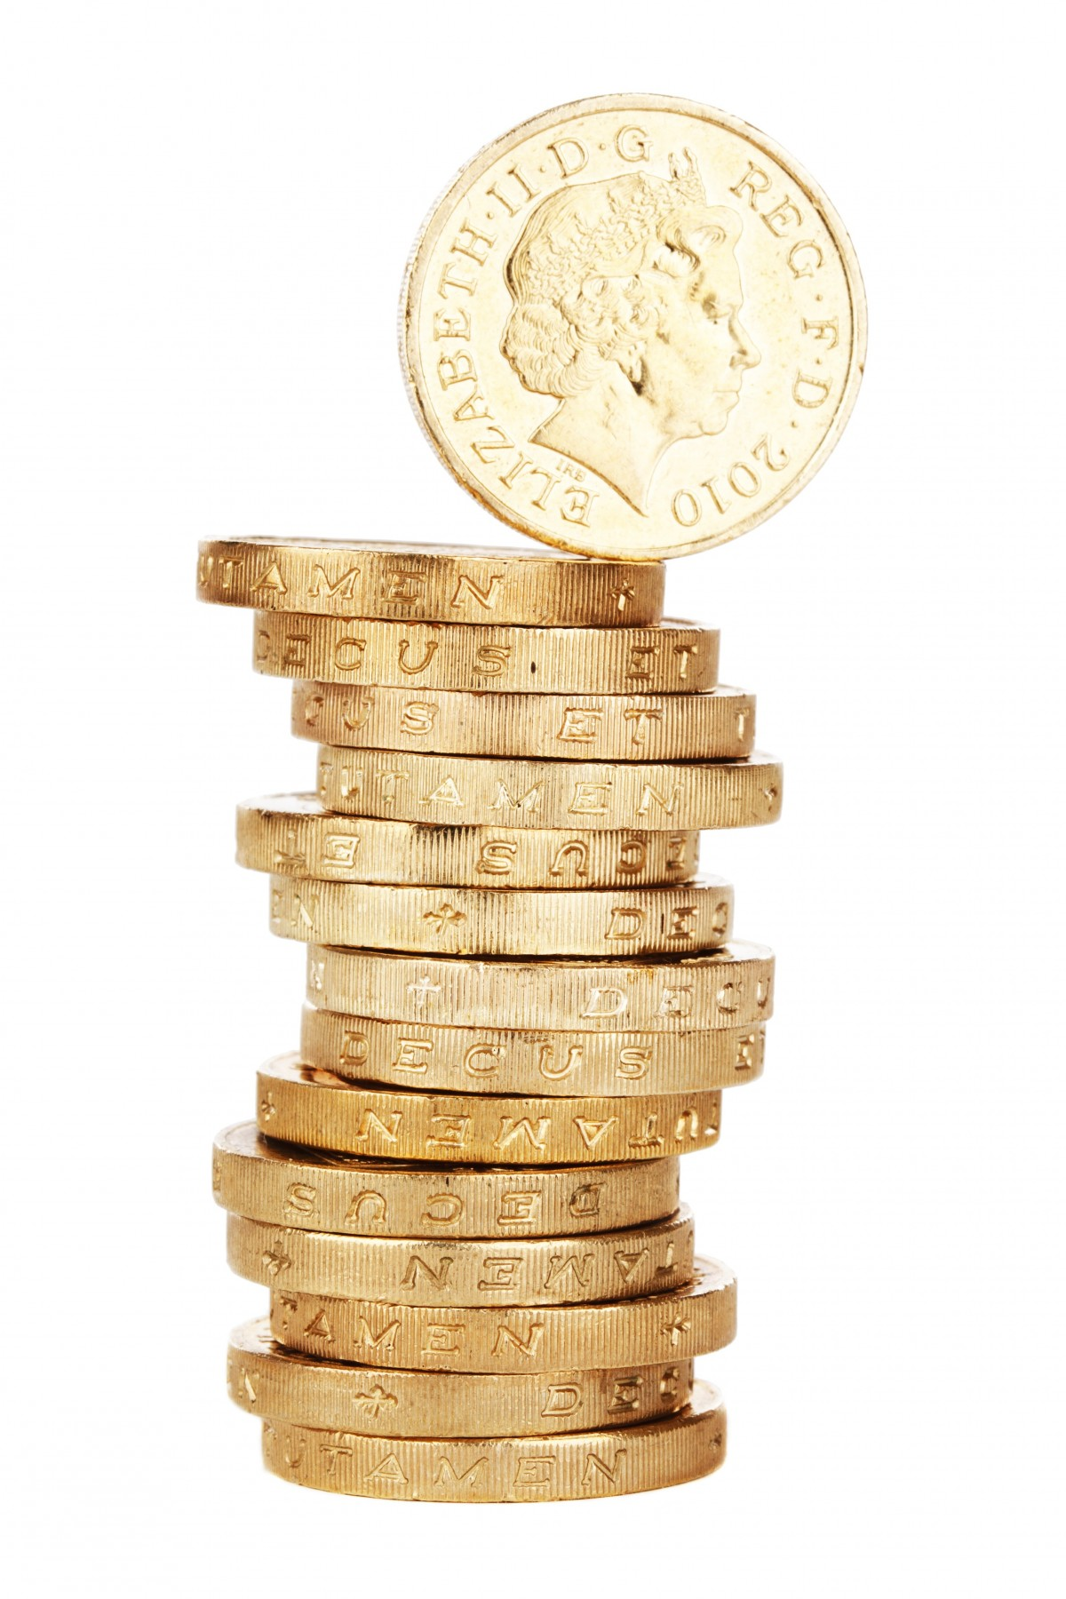
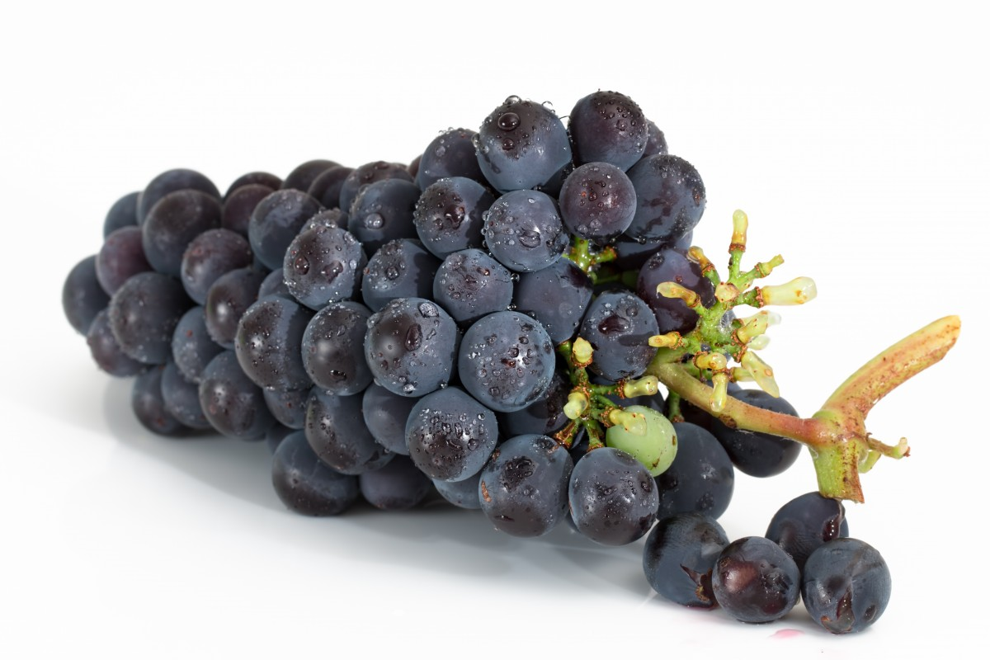
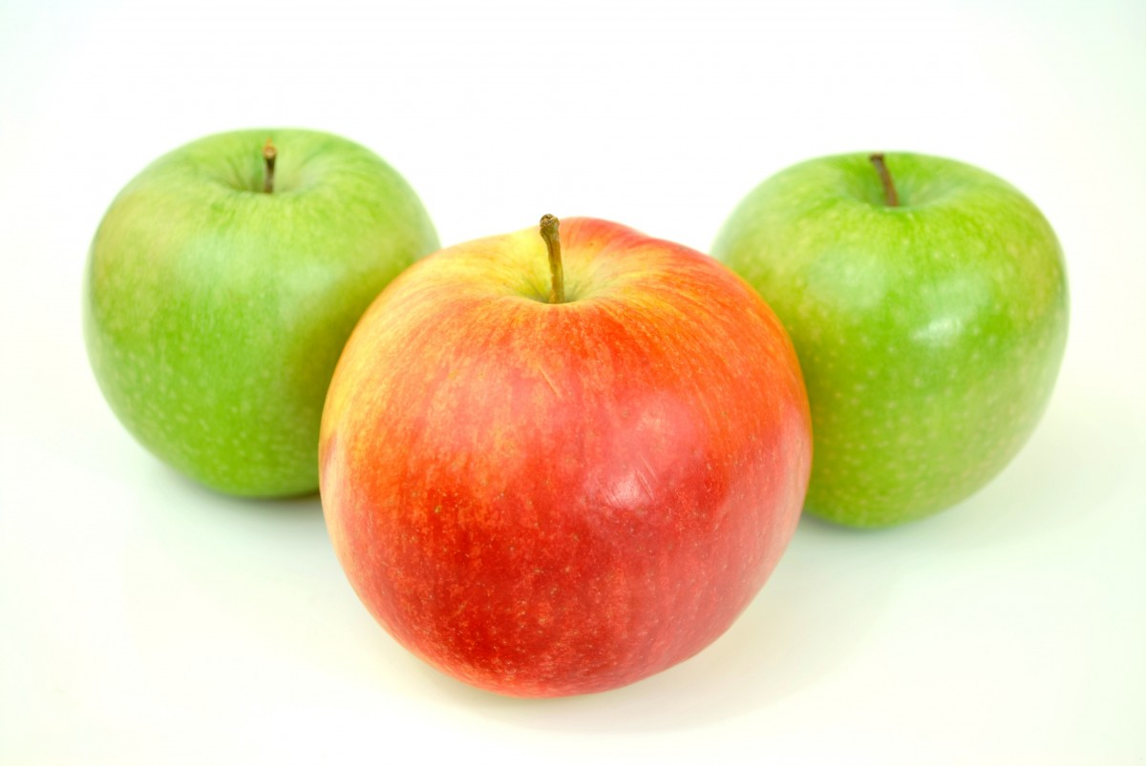
Choking
Choking happens when something gets stuck in the airway
Which of these do you think a child is most likely to choke on?
How could you try and prevent choking from each of these items?
Notes:
Answer: These are common items that cause choking in children
Choking prevention- Encourage people to sit whilst eating and to chew food well, chop/cut food in to small pieces, keep small objects out of reach etc.
Think of shape of airway and shape of object e.g slice grapes in half etc

Slide 12
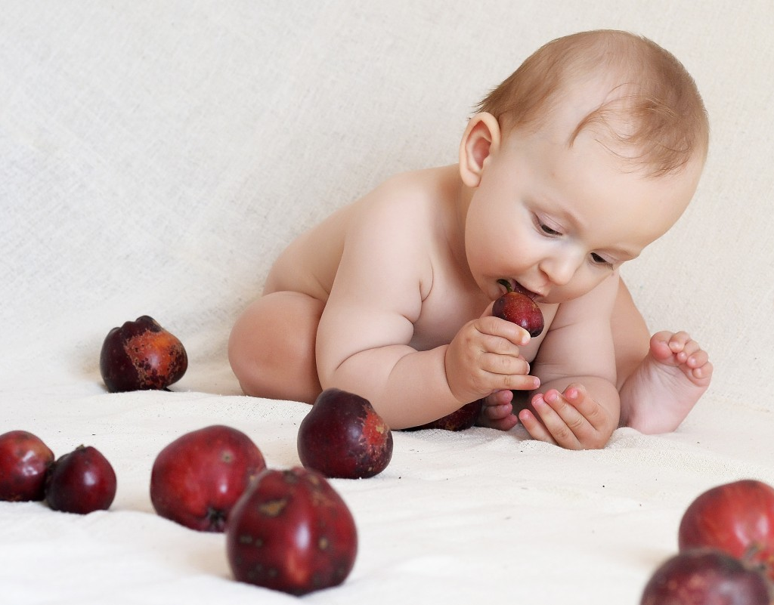
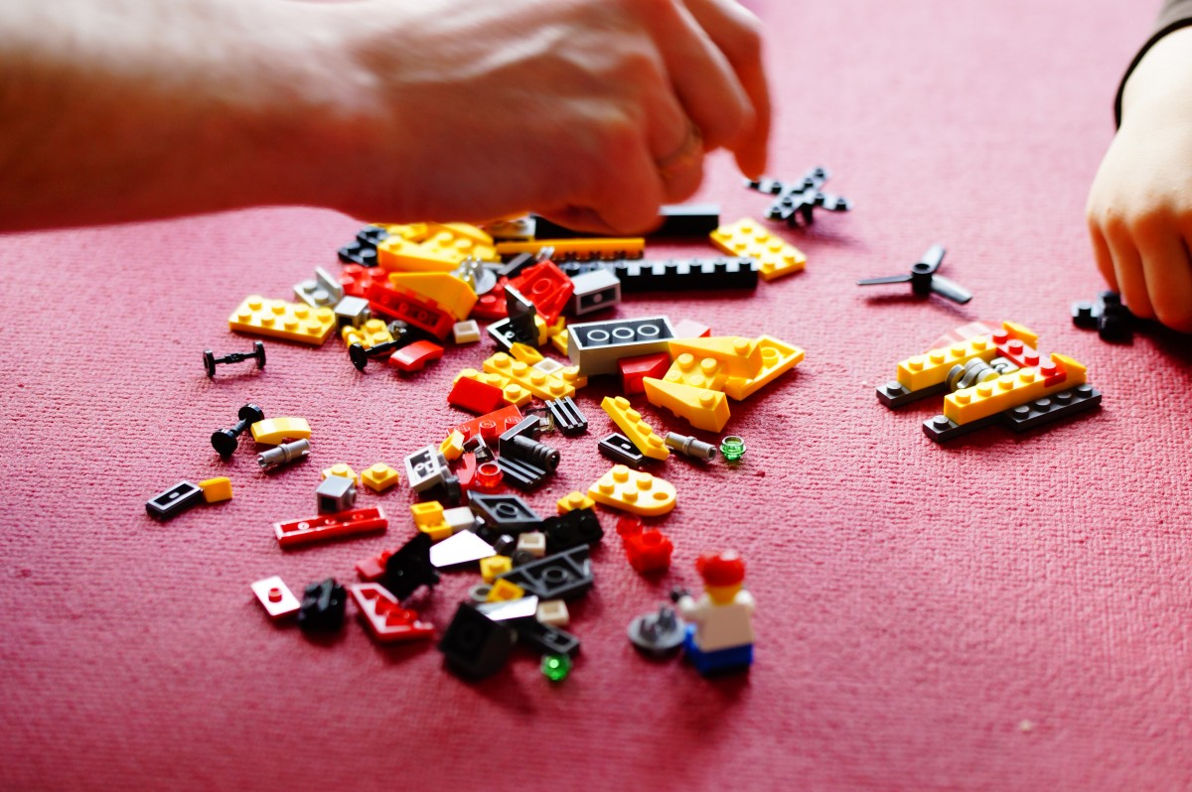
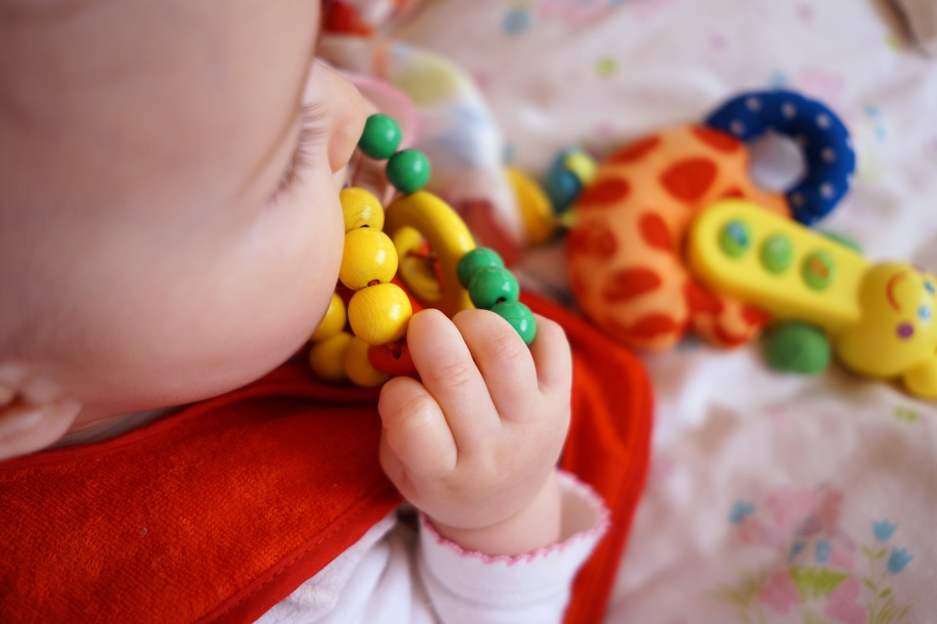
Children choking A38
Choking is quite a _ _ _ _ for children, especially those that are under the age of 3 years (ROSPA July 2019)
They put objects in their _ _ _ _ _ to explore them.
They don’t always chew their _ _ _ _ properly.
They have small, _ _ _ _ _ _, airways.
Notes:
Answers = Risk, Mouth, Food, Narrow
Most causes are coins and food
Show a coin compared to an airway and show how it can completely obstruct windpipe .

Slide 13
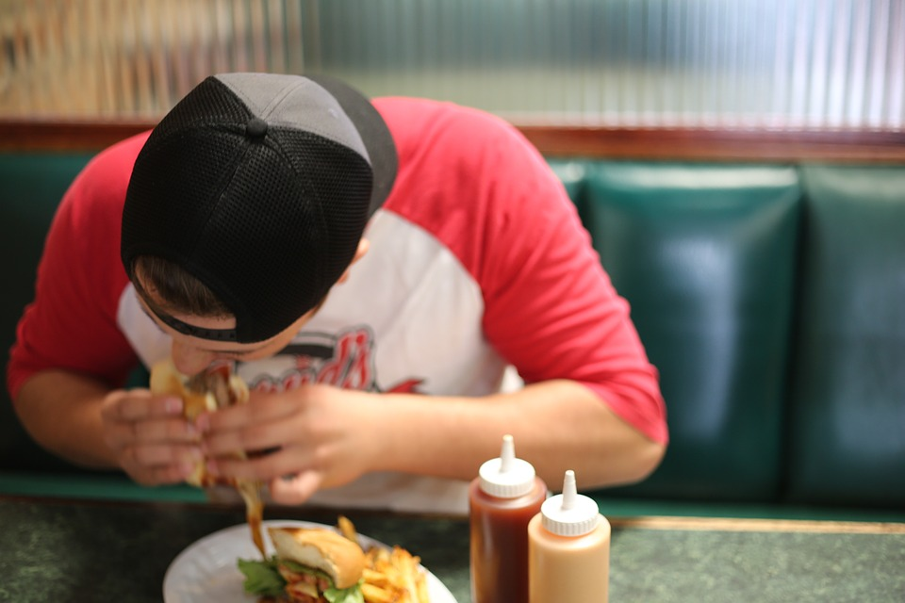

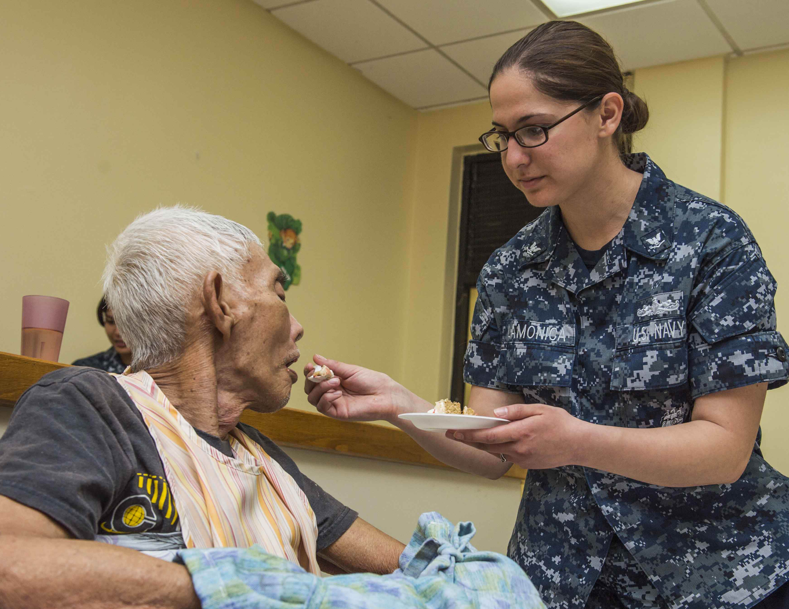
Adults choking A38
Possible causes of choking for adults:
Too much _ _ _ _ in the mouth.
Walking, talking or _ _ _ _ _ _ _ _ whilst eating.
The elderly may find it hard to _ _ _ _ _ _ _.
Burns may cause tissues in the airway to _ _ _ _ _.
Notes:
Answers = allergic, food, laughing, swallow, swell
Note: elderly may lose muscle tone so their swallow reflexes are affected

Slide 14
Watch this video
CHOKING

Slide 15
Your turn: Choking
1 Ask:
‘are you choking?’
2 Encourage
casualty to cough
3 Give
up to 5 back blows using the heel of your hand between their shoulder blades
4 Give
up to 5 ‘tummy’ thrusts (abdominal thrusts)
5 Help
if still choking call 999/112 for emergency help
Repeat the cycle if necessary
Remember: Your casualty could become unresponsive. Be prepared to perform CPR
Notes:
Scenario cards are available which the teacher can use to make the practical activity relevant in a certain context for students.

Slide 16
Activity
Quiz time
Students could now demonstrate their learning by working in small groups or pairs and creating a quiz about the topic of choking.
Once finished, students could test their classmates on their knowledge.

Slide 17
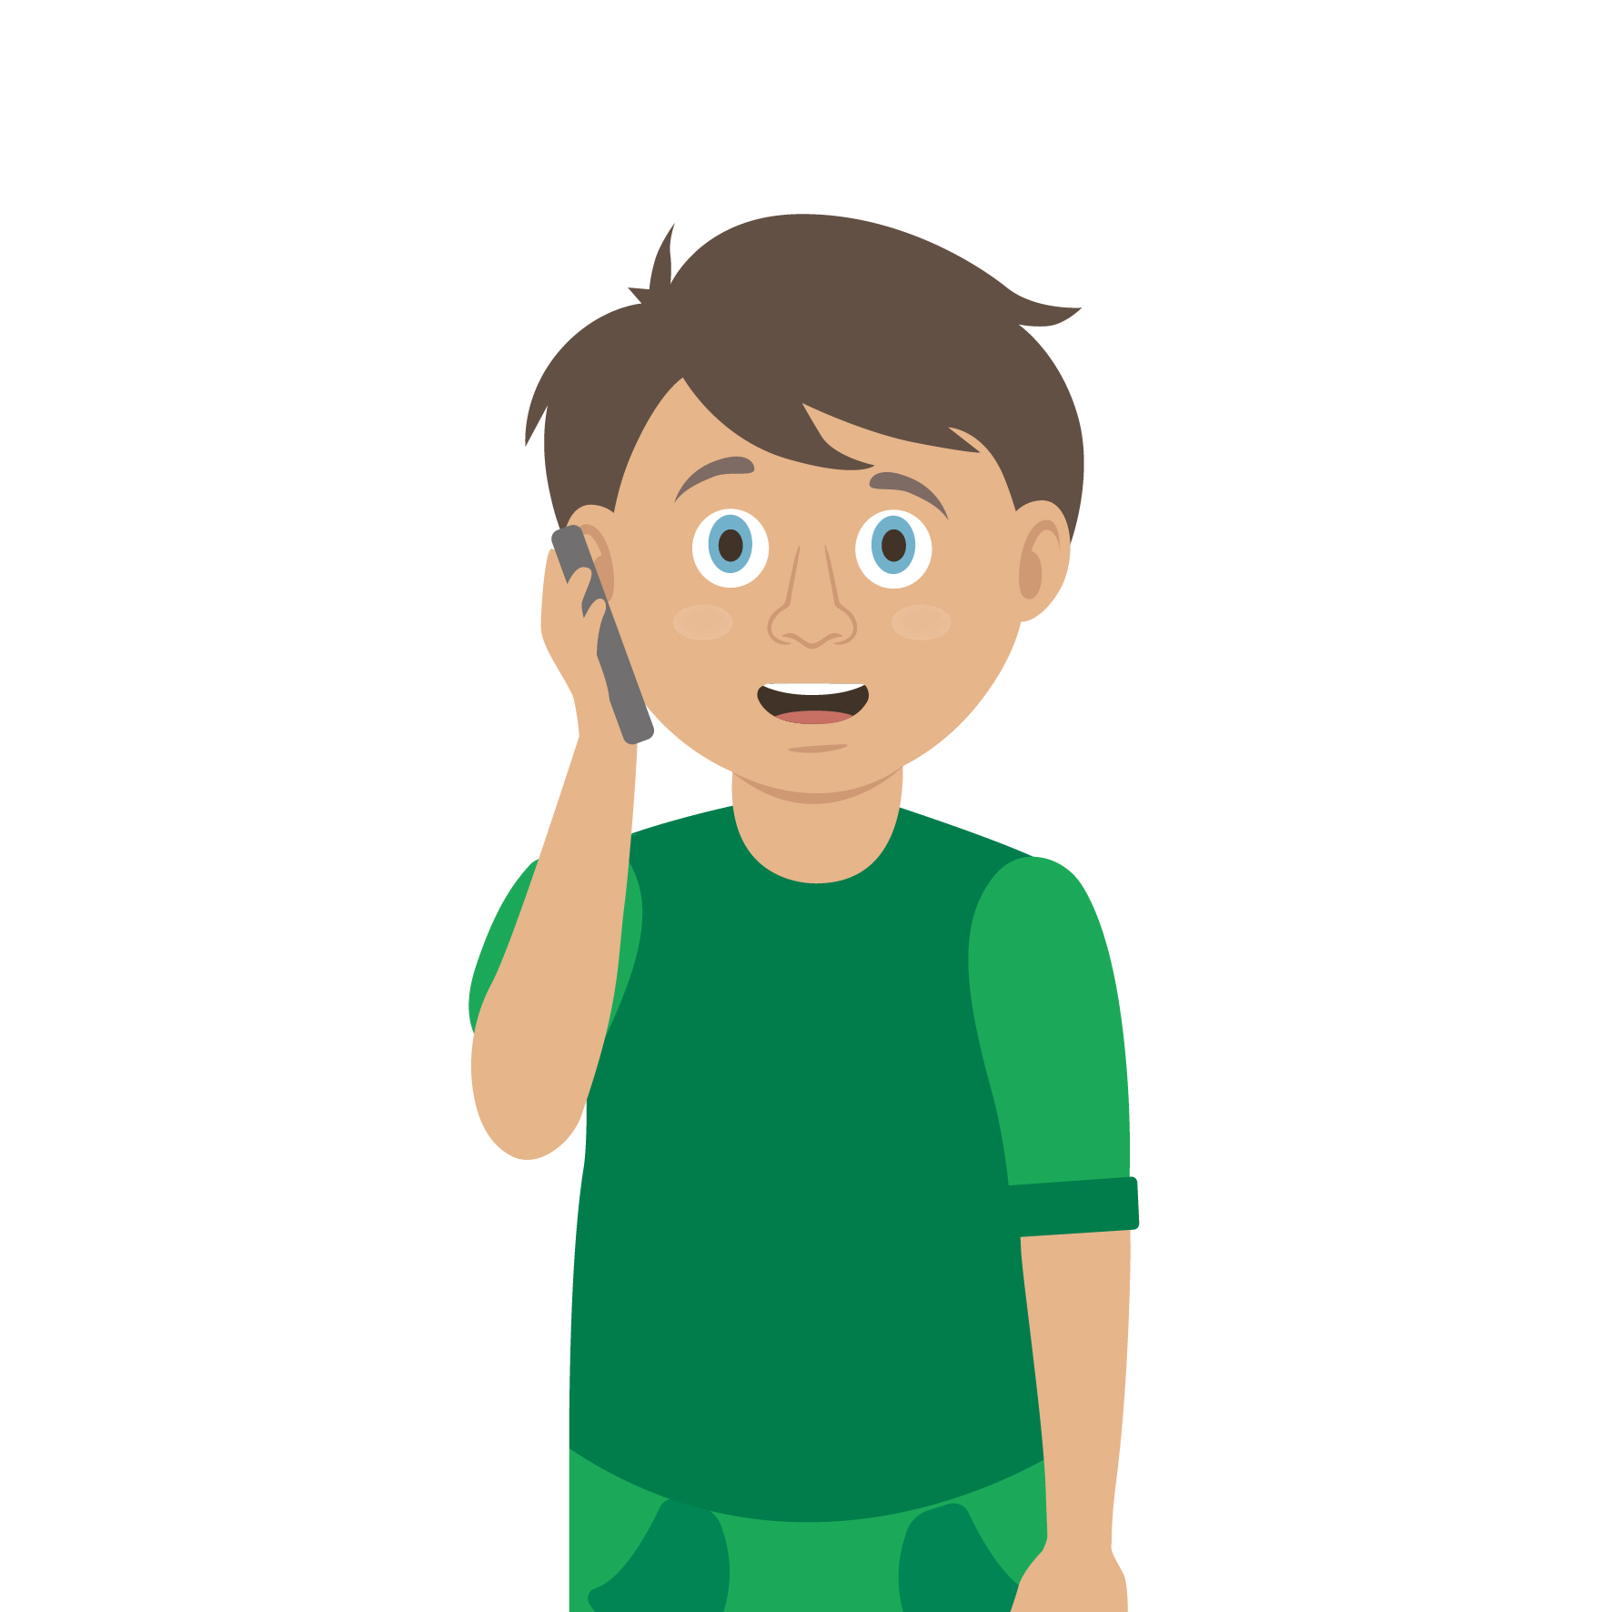
Casualty care
Pause for thought...
Which actions do you think are most important when caring for a casualty?
Get help
No food or drink
Prevent condition worsening
Remain calm
Keep warm
Treat with dignity and respect
Reassure casualty
Communicate well
Notes:
Opportunity to discuss common casualty care skills which are necessary in all first aid situations.

Slide 18



Check your learning
I am able to:
Identify when someone is choking
Give first aid to a casualty who is choking
Call for help correctly, if it is necessary
YES UNSURE NO

Slide 19

Check your knowledge
Choking
Revisit the starter activity on the first slide of this presentation. Using a coloured pen can you....
1. Add more detail to your previous answers?
2. Make any corrections?

Slide 20

Information and support
If any of the content in this session has upset or concerned you please discuss this with one of the teachers at your school
Further support can be found at:
www.childline.org.uk
www.youngminds.org.uk
www.samaritans.org
Further information linked to first aid can be found at:
www.sja.org.uk
www.asthma.org.uk

Slide 21

Thank you!

Slide 22
What’s wrong? A37
What do you think is happening?
Why?
What are the symptoms of this?
What signs do you look for?
How would the casualty be able to tell you what is wrong?
Notes:
Ask students to tell you what is happening- Quick discussion
A SIGN is something you can see.
A SYMPTOM is something that the casualty can feel.

Slide 23
Signs and symptoms A37
How many of these answers did you get?
Wheezing/difficulty breathing
Unresponsive
25
21
Can’t speak
Grabbing throat
17
Coughing
21
Panicked
11
Face turning blue
14
Wide eyes
13
Total:
19
Notes:
Add up your scores

Slide 24
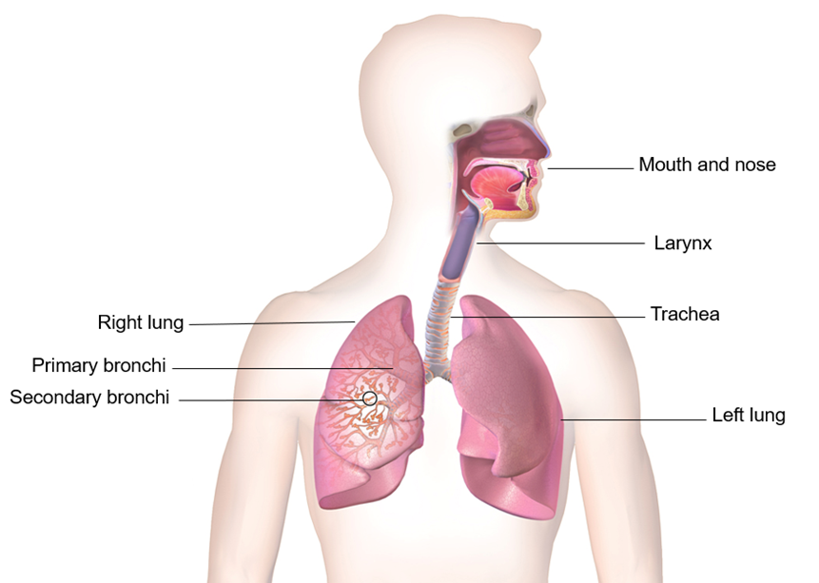
Optional activity A39
Be creative
Students now have the option to complete an extension activity. Use flip chart paper to create a diagram that demonstrates the passage of air and food. Then use the diagram to explain and label how choking may occur, research or use Slides 8-10 in this presentation to help with this task.

Slide 25
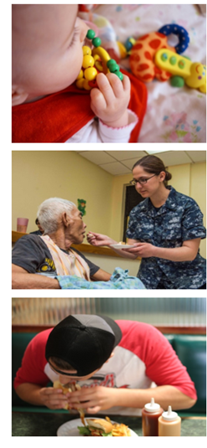
Adult and child choking A38
Choking is a quite a _ _ _ _ to children, especially those that are under the age of three.
They put objects in their _ _ _ _ _ to explore them.
They don’t always chew their _ _ _ _ properly.
They have small, _ _ _ _ _ _, airways.
S&C
Complete and expand the sentences
Possible causes of choking for adults:
Too much _ _ _ _ in the mouth.
Walking, talking or _ _ _ _ _ _ _ _ whilst eating.
The elderly may find it hard to _ _ _ _ _ _ _.
Burns may cause tissues in the airway to _ _ _ _ _.
Notes:
Ans
RISK, MOUTH, FOOD, NARROW
FOOD, RUNNING, SWALLOW, SWELL

Slide 26
Optional Activity
Role play
Students now have the opportunity to role play a first aider dealing with choking (use slide 15). They should create 2 scenarios that demonstrate different causes of choking and can also use the your turn choking handout, which can be found on the St John Ambulance website, to help.

