Slide 1
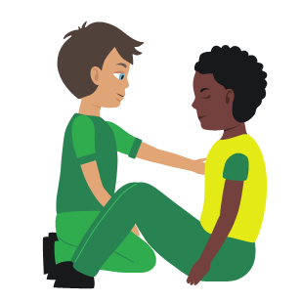
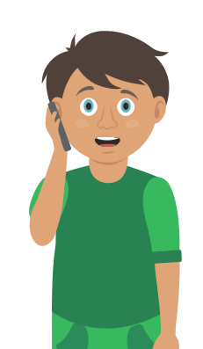

Your turn: Minor head injury
Tick the box if you can successfully complete the key step…
1. Help your casualty to sit down
2. Apply a cold compress to the injured area
Treat any wounds
3. Monitor your casualty
Watch for drowsiness and vomiting
4. Get help if necessary
Notes:
Trainer demonstrates then gets the students to practice using either the PP slide as a prompt or the sheet in the workbook. Trainer circulate and correct as necessary
Severe head injury to be covered with severe bleeding

Slide 2
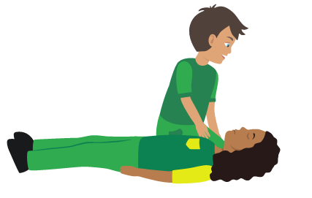
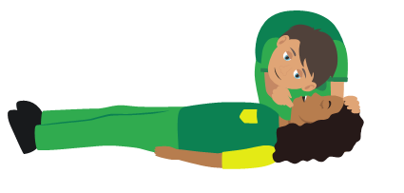
Your turn: Severe head injury
Tick the box if you can successfully complete the key step…
1. Dial 999/112 for emergency help
2. Do NOT move your casualty if you suspect they could have a neck injury
3. Make sure the airway is open
4. Treat any serious wounds
5. Monitor casualty until emergency help arrives
Notes:
Trainer demonstrates then gets the students to practice using either the PP slide as a prompt or the sheet in the workbook. Trainer circulate and correct as necessary
Severe head injury to be covered with severe bleeding

