Slide 1
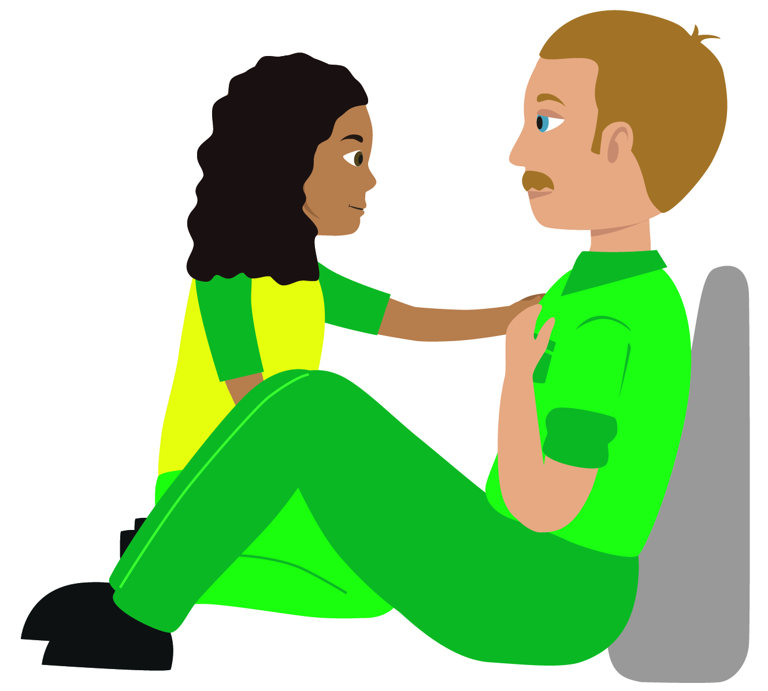
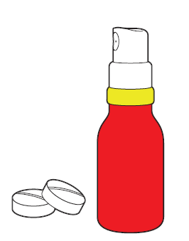
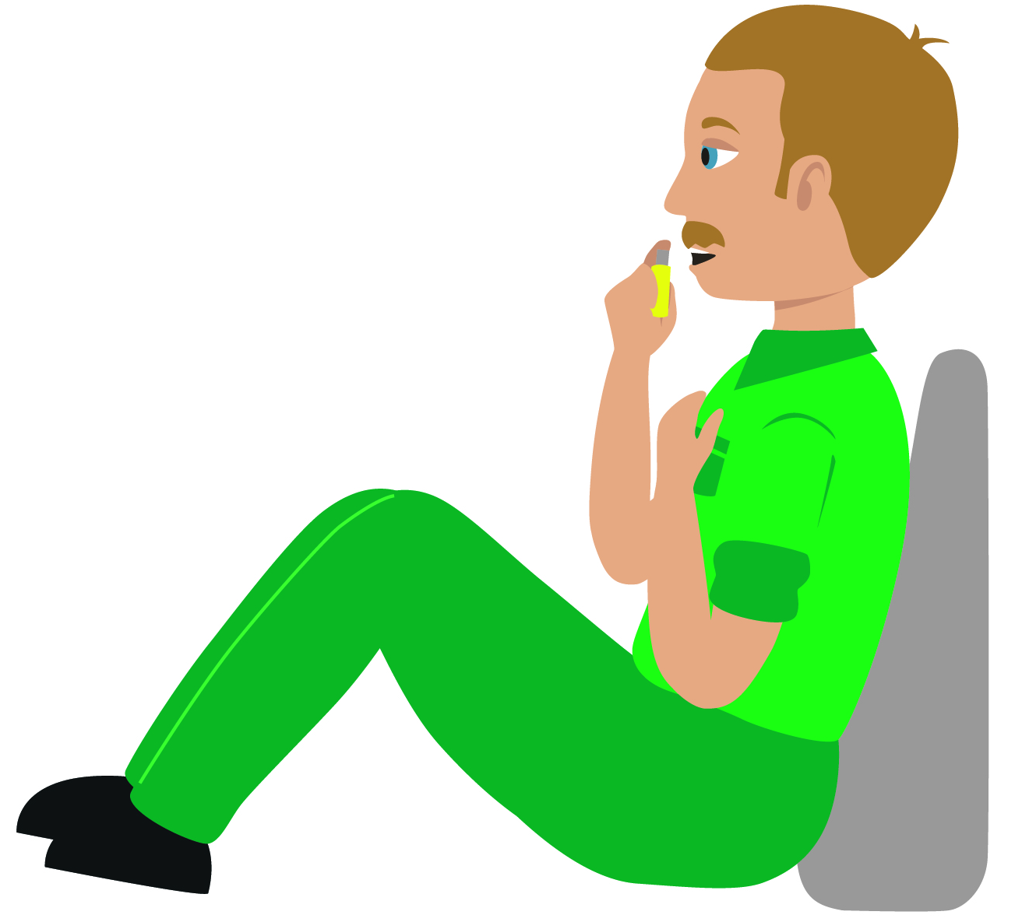
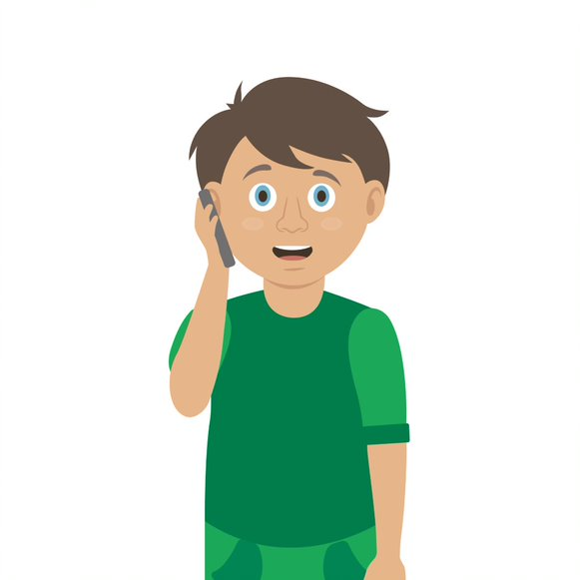

Your turn: Chest pain
Tick the box if you can successfully complete the key step…
Help the casualty to sit down
Sit them on the floor with pillows behind their back
2. Encourage them to take medication if they have any (tablet or spray)
3. If the pain persists after 5 minutes advise them to take another dose
4. Call 999/112 if the pain is not easing after the second dose (suspect a heart attack)
5. Keep them calm and reassure them until help arrives
Notes:
In pairs/ small group demo management of chest pain (angina)
Q. Why is it important that we do not let the casualty eat or drink? The casualty must be prevented from eating and drinking as their body is already under stress and digesting food / drink will put additional strain on heart. Also, if they are going to hospital they may receive treatment that requires them NOT to have eaten or drank. (operation etc)

