Slide 1
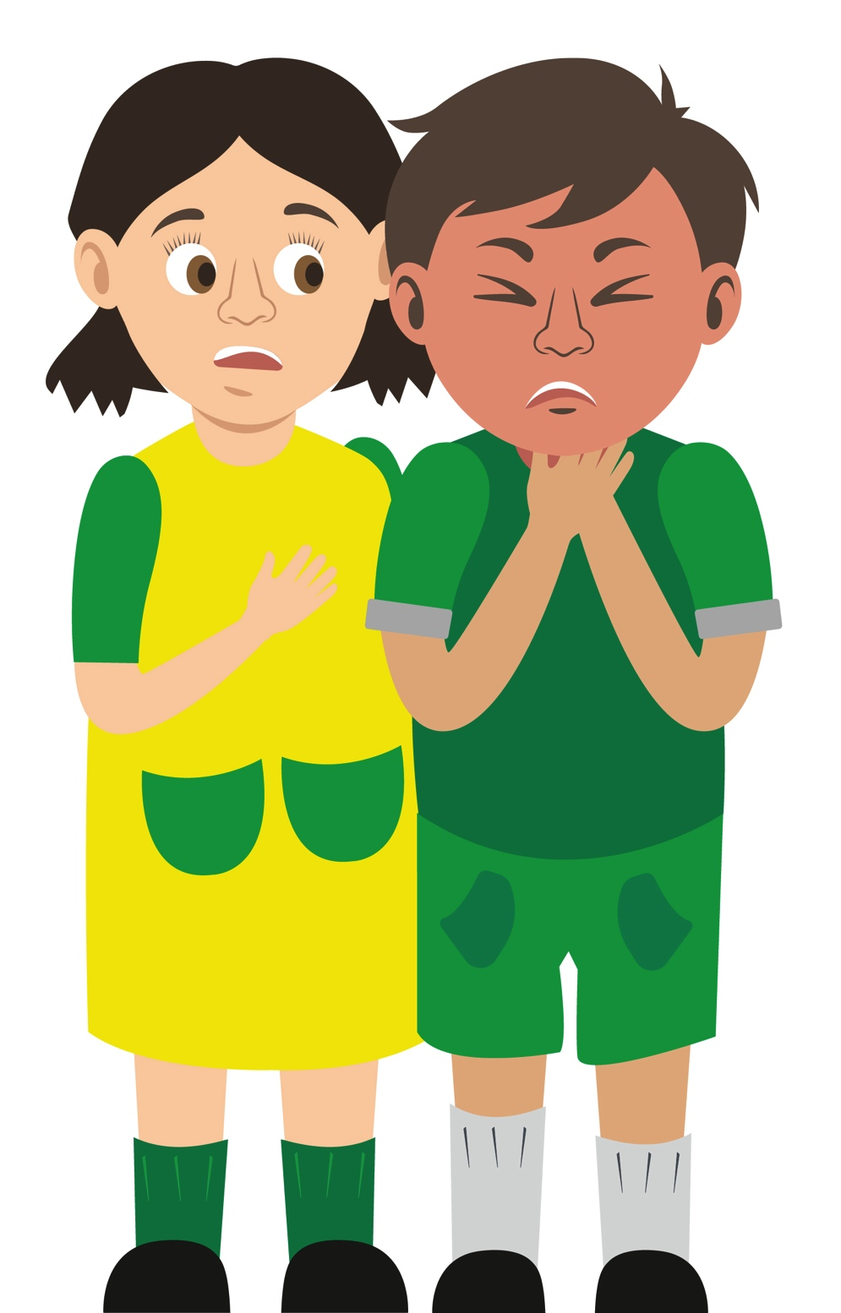
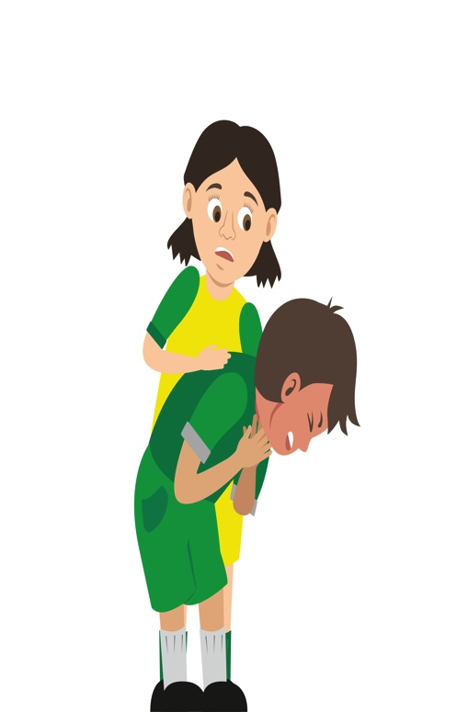
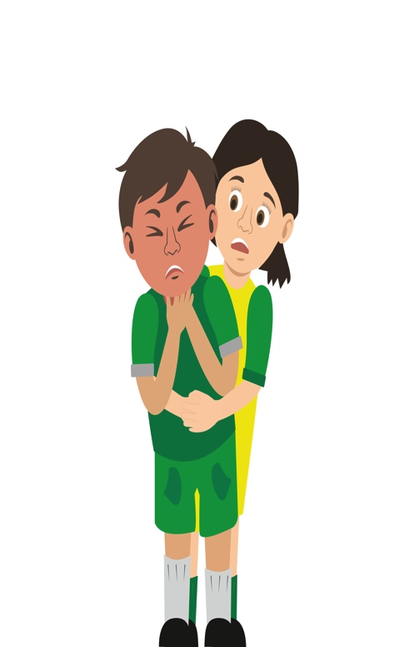
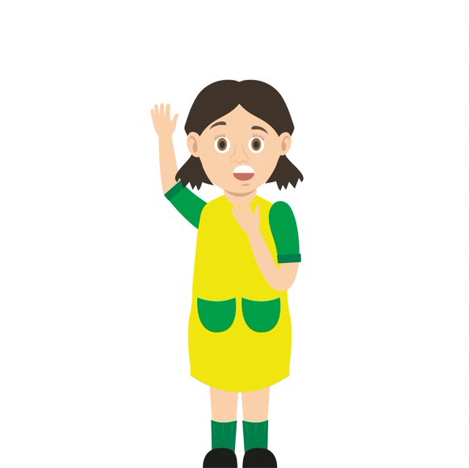

Starter Activity
Choking
Use your current first aid knowledge to explain what you could do for each of the 6 steps.
Step 1.
Step 2.
Step 3.
Ask
____________________
Encourage
____________________
Give
up to 5 ______________
____________________________________________________________
Step 4.
Step 5.
Step 6.
Give
up to 5 ______________ (___________________)
Help
_________________________________________________________
____________________________________________
Remember: ________________________________________________________________________________
These images may be able to help you with your answers
Notes:
Try to complete the steps to demonstrate your knowledge at start of session
Once session complete add to your work or make any amends

Slide 2
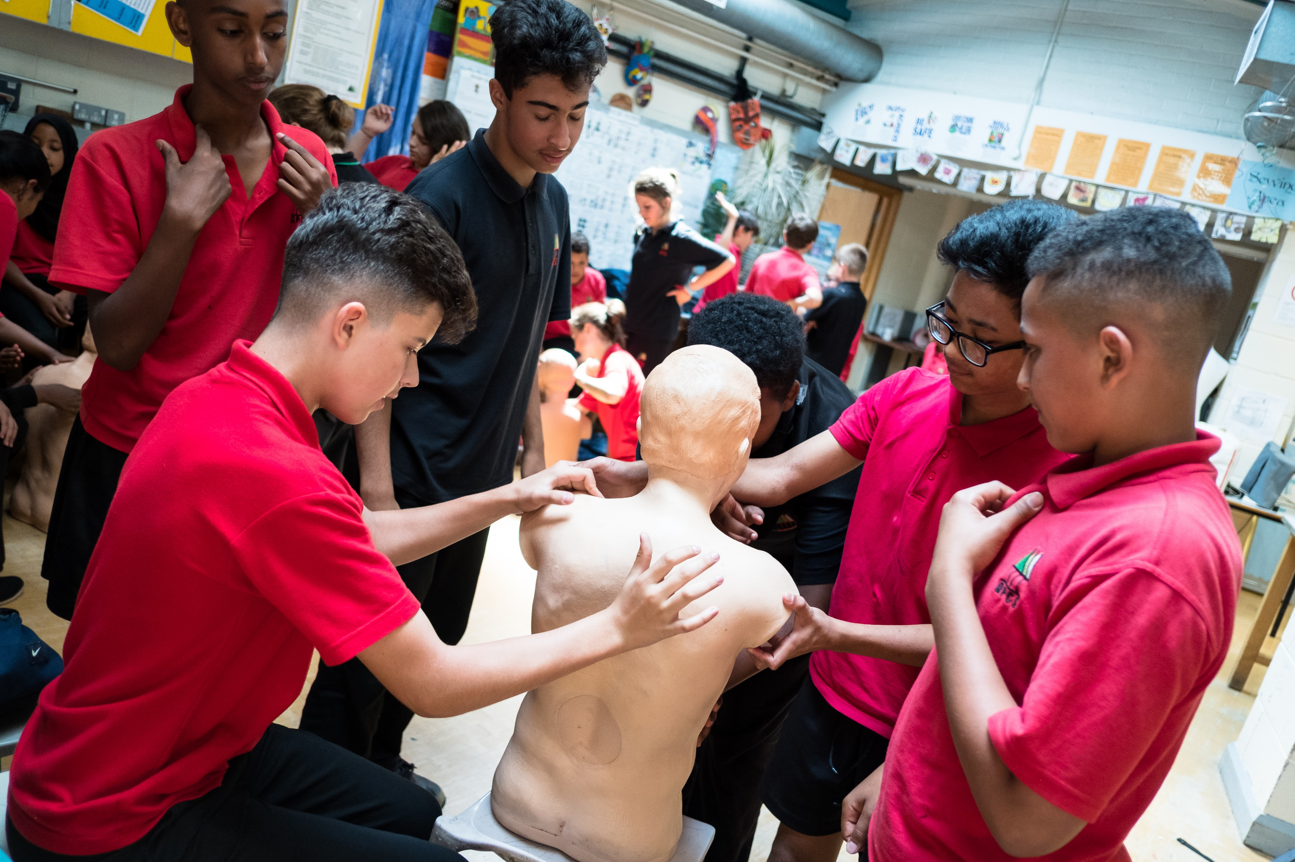


Choking
KS4 – Choking

Slide 3
Choking
A short course to learn how to deal with a casualty who is choking.

Slide 4
Learning outcomes
I am able to recognise when someone is choking
I can give first aid to a casualty who is choking
I am able to get help for a casualty who is choking.
Notes:
Teacher should refer to ground rules for the session at this stage

Slide 5
Casualty care
Always talk to the casualty.
Listen carefully to what the casualty says (if they are able to talk).
Try to make sure the correct information is available before dialing 999 or 112.
Notes:
It should be noted that a casualty may not be able to communicate if they are choking but the first aider needs to be advised that they should always talk to the casualty and let them know what is happening

Slide 6
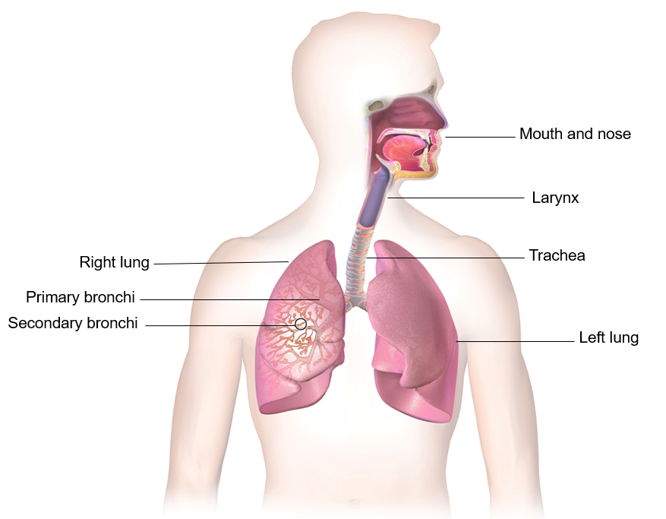
Anatomy of the airway
We breathe in (inspiration) and out (expiration).
This whole process is called respiration.
The average adult respiration rate is 14 – 20 times per minute.
The ribs help to protect the important chest organs – the heart and lungs.
S&C: How many times would somebody breathe in and out in a day if they breathe 15 times per minute?
Notes:
Answer = 15 x 60 (mins in an hour) = 900. x 24 (hours in a day) = 21,600 times.

Slide 7
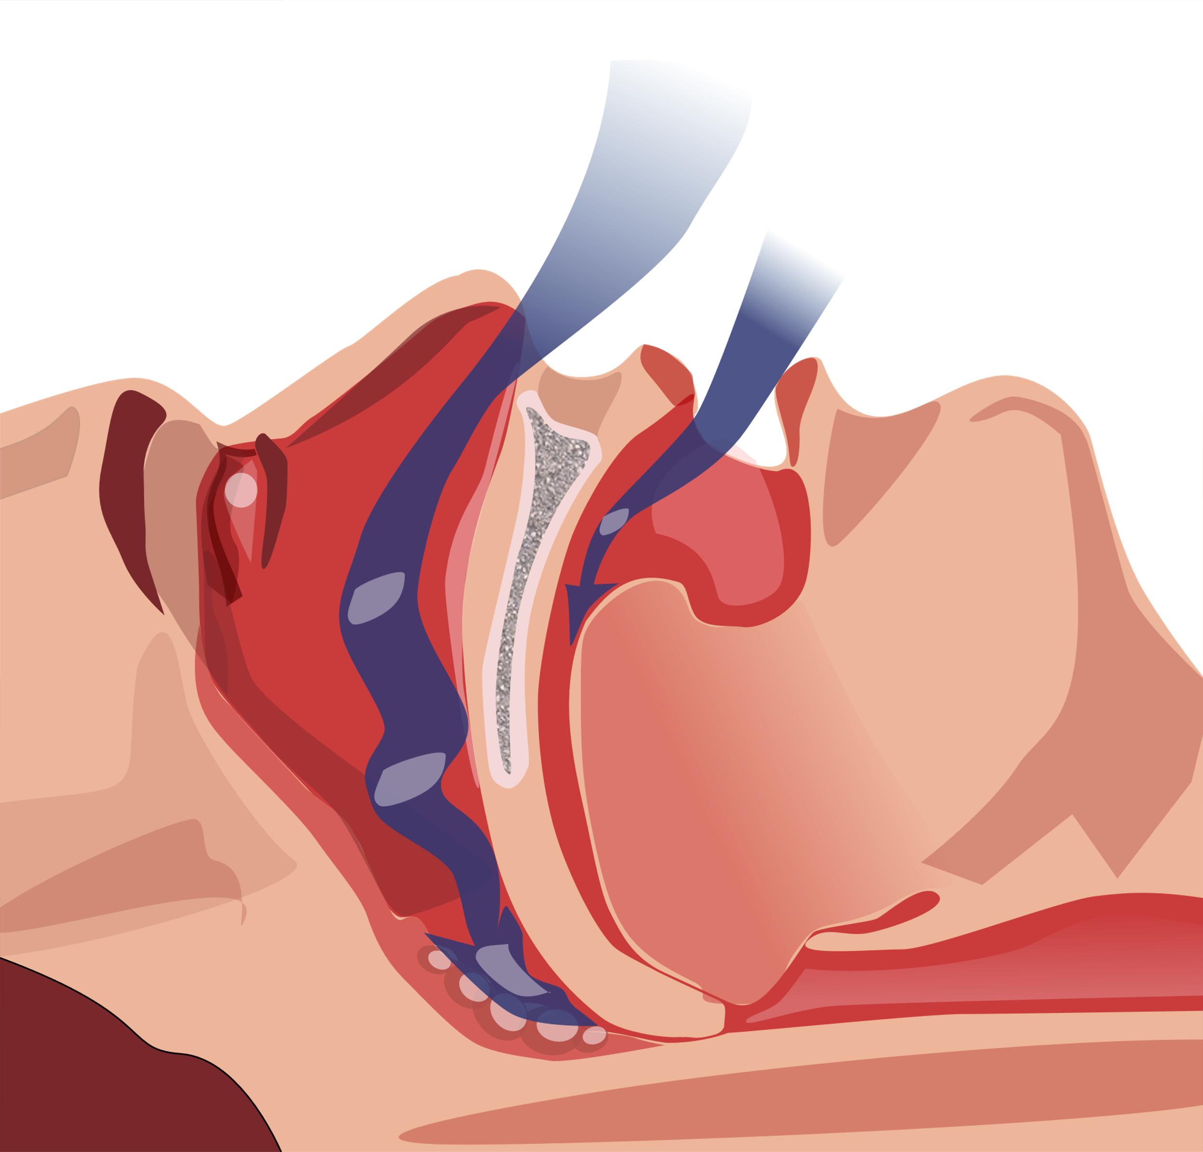
Emergencies of the airway
The airway could be blocked due to a restriction. This could be caused by tissues of the airway narrowing due to swelling brought on by allergies, burns etc.
The airway could be blocked due to an object. This is known as an obstruction. This could be food, foreign body or the tongue if the casualty is unresponsive.

Slide 8
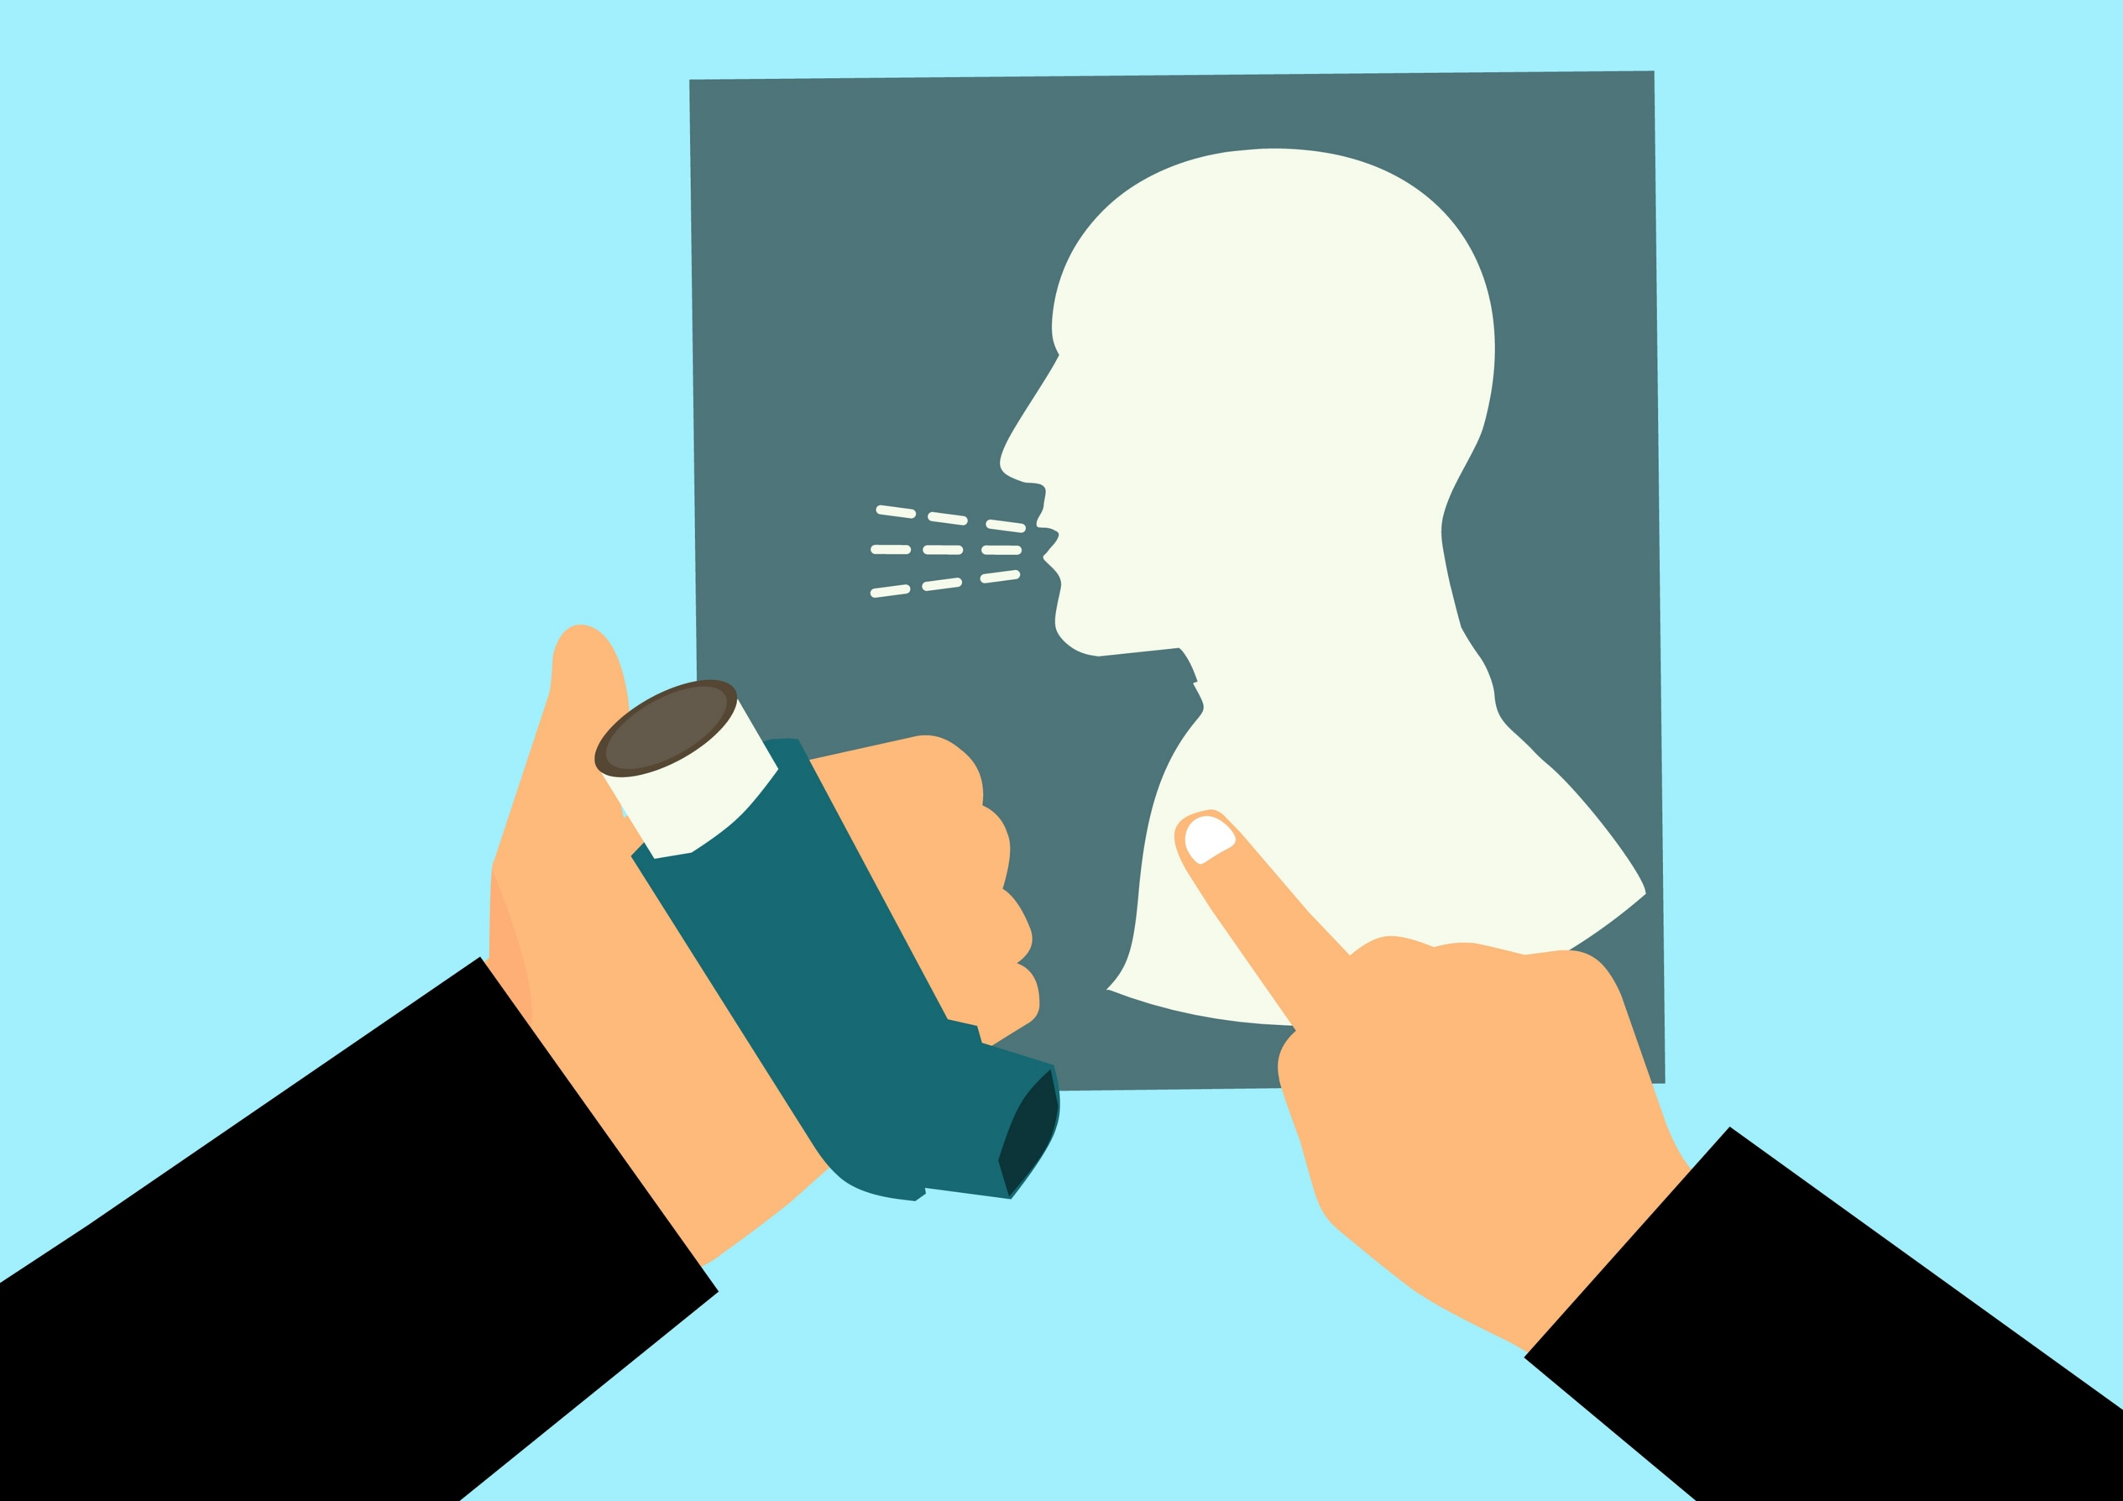

Obstruction vs restriction
Obstruction key words:
Blocked
Obstruction
Unable to breathe
Object in throat
Coughing
Holding throat
Restriction key words:
Narrow airway
Difficult to breathe
Tight chest
Possibly wheezing
Possibly swelling
Coughing

Slide 9


What’s wrong?
What symptoms might there be?
What signs might there be?
Why could this be happening?
How could the casualty tell somebody what is wrong?
What could be happening?
Notes:
Ask students to tell you what is happening – has it ever happened to them? Quick discussion
A SIGN is something you can see.
A SYMPTOM is something that the casualty can feel.

Slide 10
Signs and symptoms
How many of these answers did you get?
Wheezing/difficulty breathing
Unresponsive
25
21
Can’t speak
Grabbing throat
17
Coughing
21
Panicked
11
Face turning blue
14
Wide eyes
13
Total:
19
Notes:
Add up your scores

Slide 11
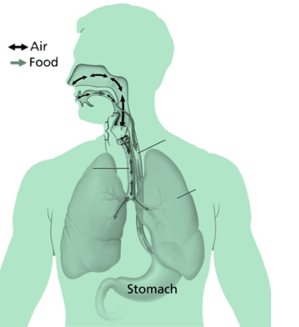
Passage of air and food
Epiglottis:
A flap in the throat that prevents food entering the windpipe
Oesophagus:
A muscular tube approx. 25 cm long
It connects the mouth to the stomach
The walls of the oesophagus contract to move the food along the tube into the stomach
Trachea (windpipe) :
a cartilaginous tube that connects to the lungs
Is present in all air breathing animals
It allows the passage of air and extends from the larynx into the primary bronchi of the lungs
Oesophagus
Left lung
Notes:
Explain that as we put food in our mouth, chew and swallow sometimes the food goes down the airway instead of down the oesophagus.

Slide 12
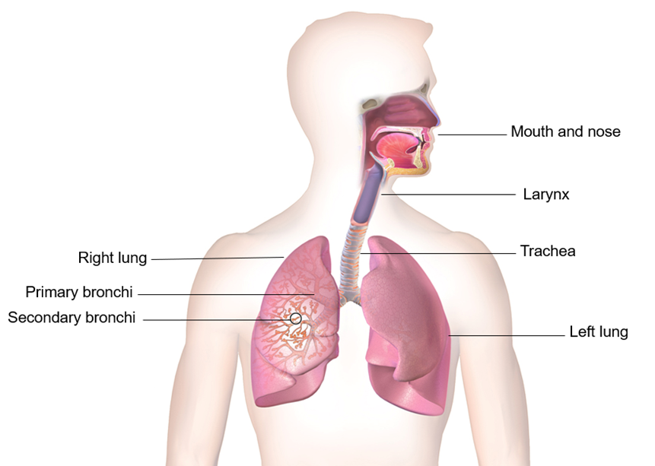
Activity A39
Be creative
Students now have the option to create a poster that demonstrates the passage of air and food. Use the poster to explain and label how choking may occur, research or use slides within this presentation to help with this task.

Slide 13
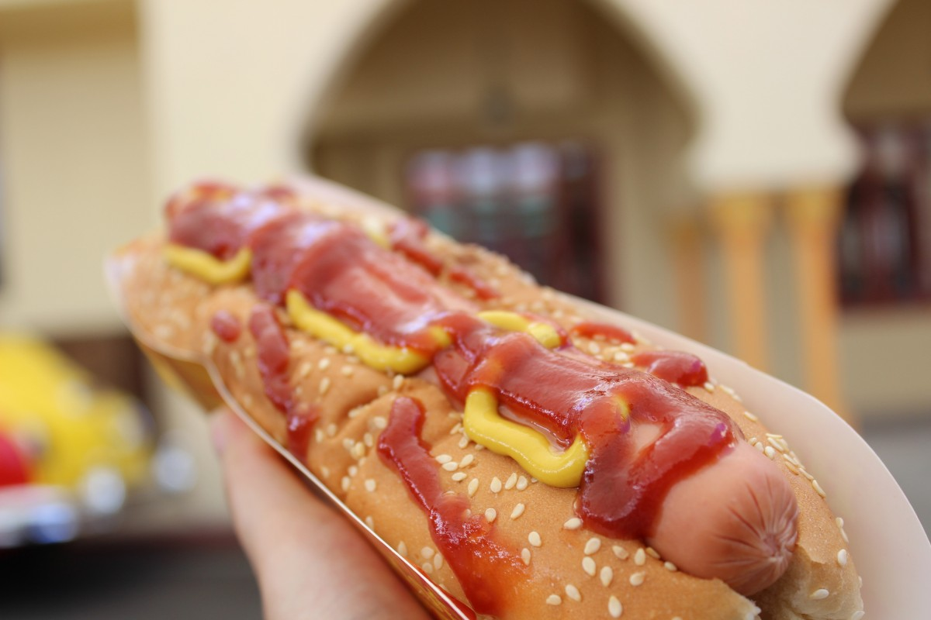
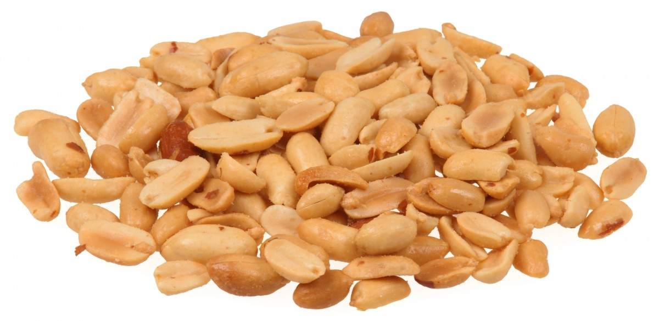
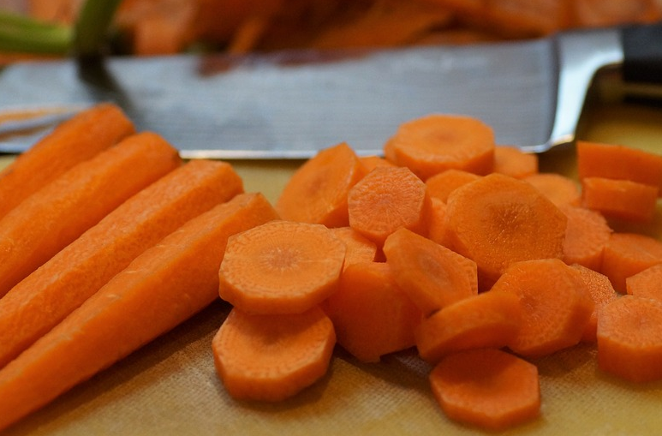



Choking
Choking happens when something gets stuck at the back of your throat.
Which of these do you think a child is most likely to choke on?
What could you do to try and prevent choking from happening?
Notes:
- All of these are the most common items that cause choking
- Encourage people to sit whilst eating and to chew food well, chop/cut food in to small pieces, keep small objects out of reach etc.

Slide 14
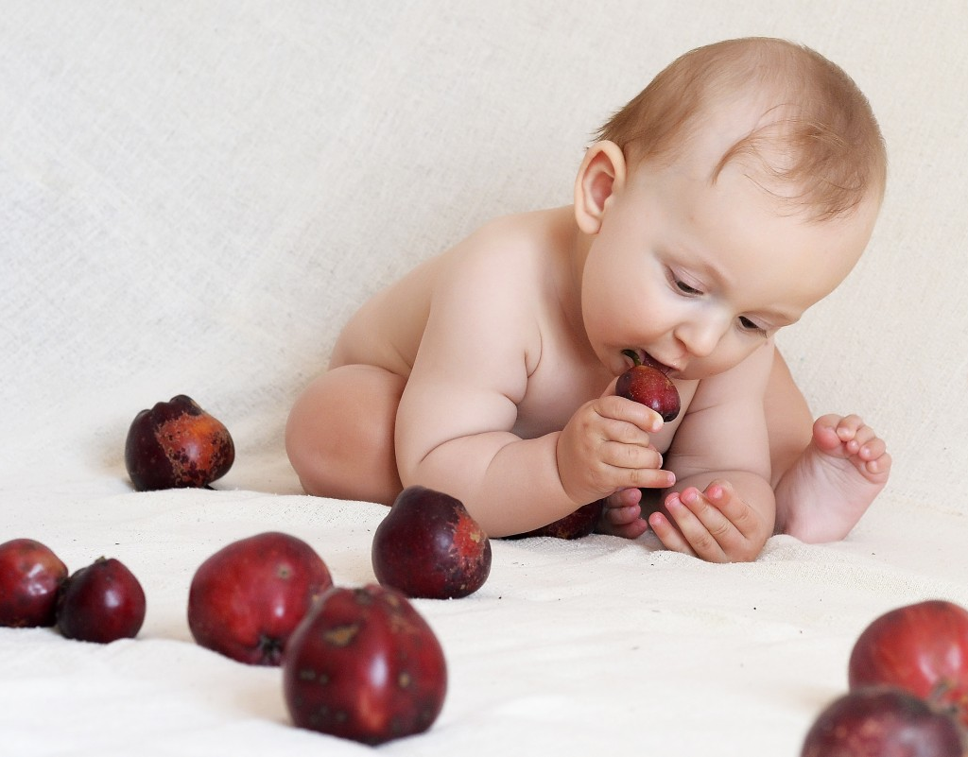
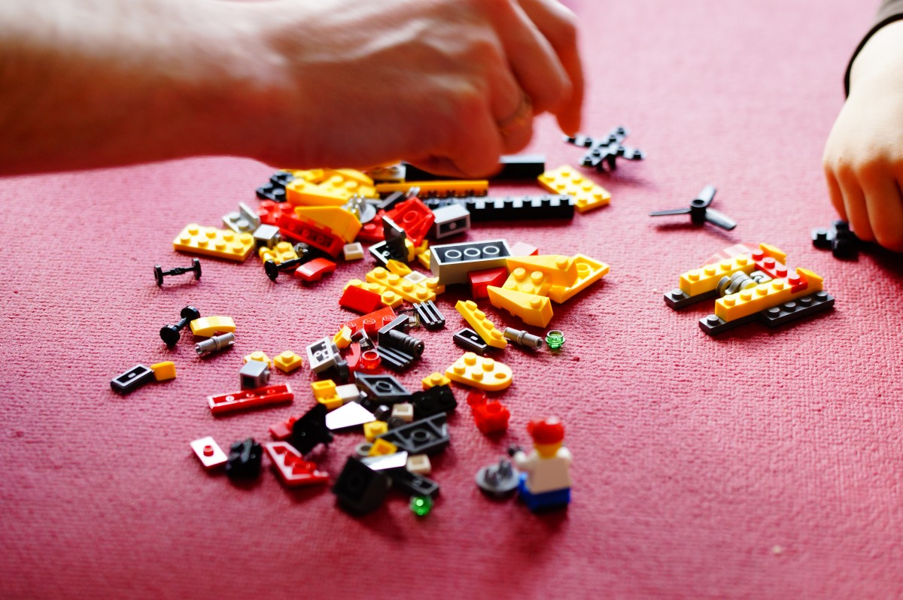
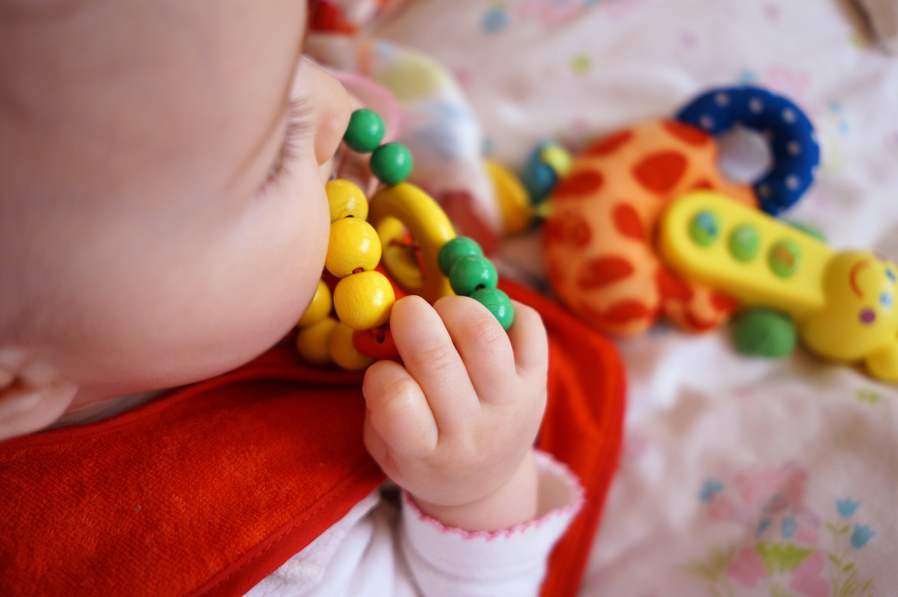
Children choking A38
Choking is a _ _ _ _ for children, especially those under the age of three.
They put objects in their _ _ _ _ _ to explore them.
They don’t always chew their _ _ _ _ properly.
They have small, _ _ _ _ _ _, airways.
Notes:
Ans
RISK, MOUTH, FOOD, NARROW

Slide 15
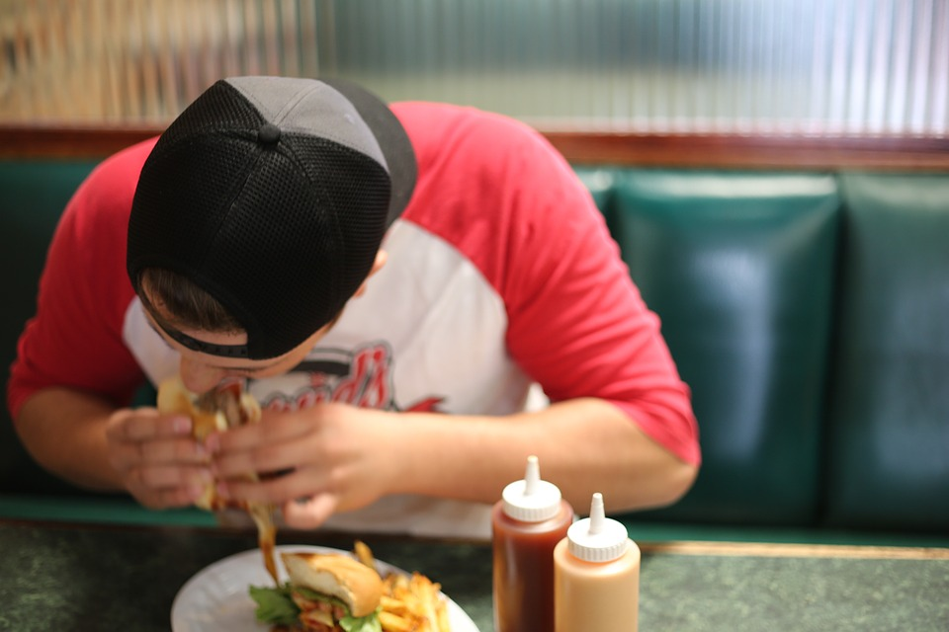

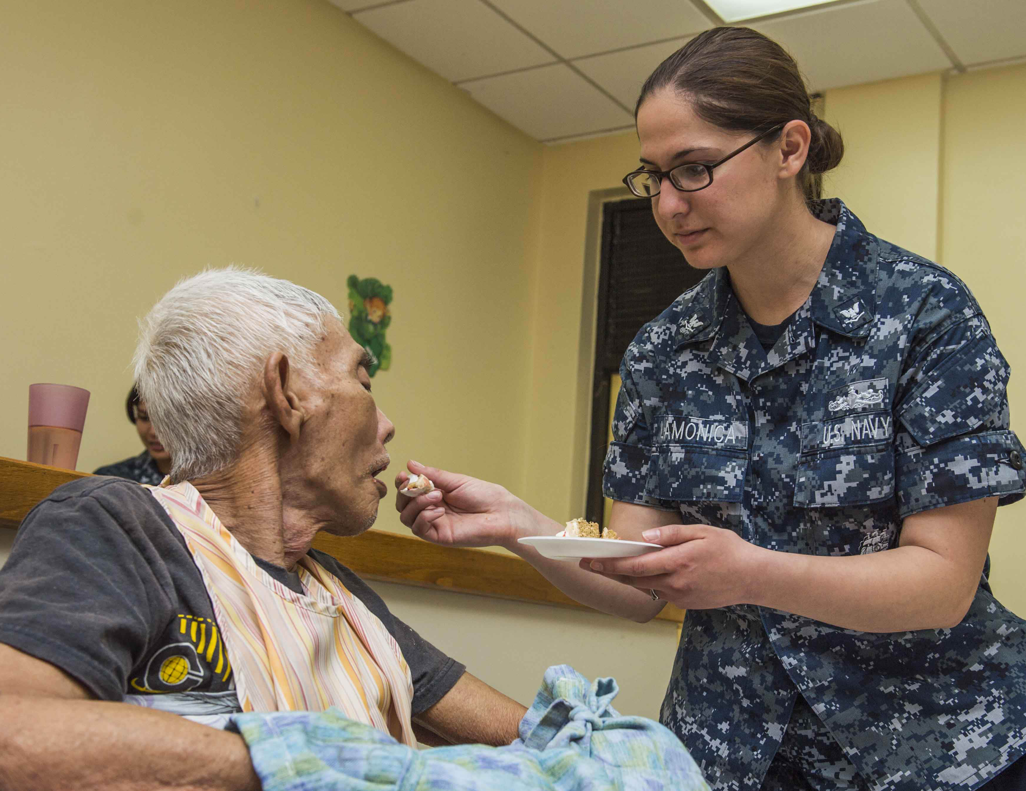
Adults choking A38
Possible causes of choking for adults:
Too much _ _ _ _ in the mouth.
Walking, talking or _ _ _ _ _ _ _ _ whilst eating.
The elderly may find it hard to _ _ _ _ _ _ _.
Burns may cause tissues in the airway to _ _ _ _ _.
Notes:
Answers = Food, Laughing, Swallow, Swell

Slide 16
Watch this video
Choking

Slide 17
Your turn: Choking
1. Ask
‘Are you choking?’
2. Encourage
casualty to cough
3. Give
up to 5 back blows using the heel of your hand between their shoulder blades
4. Give
up to 5 ‘tummy’ thrusts (abdominal thrusts)
5. Help
if still choking call 999/112 for emergency help
Repeat the cycle if necessary
Remember: Your casualty could become unresponsive. Be prepared to perform CPR
KS4 – Choking
Notes:
Scenario cards are available which the teacher can use to make the practical activity relevant in a certain context for students.

Slide 18


Quick quiz
What can cause restriction of the airway?
Name two anatomical parts of the airway
What can cause obstruction of the airway?
What is the first thing you should do if a casualty is choking?
What is the process of breathing in called?
How many back blows should somebody give to a choking casualty?
Notes:
Restriction- swelling of airway , asthma, allergies, smoke inhalation
First thing is ask them “ are you choking?”
Obstruction caused by object in airway
Give “up to 5” back blows
Breathing in is called inspiration
Two anatomical parts- refer to diagram

Slide 19
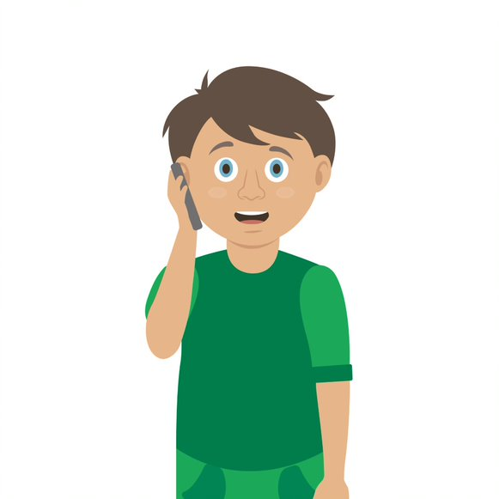
Casualty care
Pause for thought...
Which actions do you think are most important when caring for a casualty?
Get help
No food or drink
Prevent condition worsening
Remain calm
Keep warm
Treat with dignity and respect
Reassure casualty
Communicate well
Notes:
Opportunity to discuss common casualty care skills which are necessary in all first aid situations.

Slide 20



Check your learning
I am able to:
Identify when someone is choking
Give first aid to a casualty who is choking
Call for help correctly, if it is necessary
YES UNSURE NO

Slide 21

Check your knowledge
Choking
Revisit the starter activity on the first slide of this presentation. Using a coloured pen can you....
1. Add more detail to your previous answers?
2. Make any corrections?

Slide 22

Information and support
If any of the content in this session has upset or concerned you please discuss this with one of the teachers at your school
Further support can be found at:
www.childline.org.uk
www.youngminds.org.uk
www.samaritans.org
Further information linked to first aid can be found at:
www.sja.org.uk
www.asthma.org.uk

Slide 23

Thank you!

Slide 24
Activity A39
Be creative
Students now should use flip chart paper to draw a diagram to explain the passage of air and food. Use the diagram to explain and label how choking may occur, research or use slides within this presentation to help with this task.

Slide 25








Activity A25
Choking word filler
Select the words and expand answers on this worksheet. Use the downloadable worksheet which can be found on the St John Ambulance website.

Slide 26
Adult and child choking A38
Choking is a _ _ _ _ for children, especially those under the age of three.
They put objects in their _ _ _ _ _ to explore them.
They don’t always chew their _ _ _ _ properly.
They have small, _ _ _ _ _ _, airways.
S&C
Complete and expand the sentences
Possible causes of choking for adults:
Too much _ _ _ _ in the mouth.
Walking, talking or _ _ _ _ _ _ _ _ whilst eating.
The elderly may find it hard to _ _ _ _ _ _ _.
Burns may cause tissues in the airway to _ _ _ _ _.
Notes:
Ans
RISK
MOUTH
FOOD
NARROW
FOOD
LAUGHING
SWALLOW
SWELL

Slide 27
Activity A41
Storyboard
Students have the opportunity to create their own choking story board which has a minimum of 4 scenes. Be sure to include the following: a choking scenario, anatomy of the airway, signs and symptoms and correct treatment for a choking casualty. Use the downloadable worksheet which can be found on the St John Ambulance website.

Slide 28
Activity A42
The respiratory system
Students can now demonstrate their knowledge by labelling the key elements of the respiratory system. Use the downloadable worksheet which can be found on the St John Ambulance website.

Slide 29
Your turn: Choking
1. Ask
‘Are you choking?’
2. Encourage
casualty to cough
3. Give
up to 5 back blows using the heel of your hand between their shoulder blades
4. Give
up to 5 ‘tummy’ thrusts (abdominal thrusts)
5. Help
if still choking call 999/112 for emergency help
Repeat the cycle if necessary
Remember: Your casualty could become unresponsive. Be prepared to perform CPR
KS4 – Choking
Notes:
Scenario cards are available which the teacher can use to make the practical activity relevant in a certain context for students.

